Slide 1
SEM-1 L.A.L.P
Dr. Pradeep.J.Jha

Slide 2
LALP.1
Part 1 Quantities are of two types.
1 Scalar and 2 Vector
1 Scalar Quantities are the real values-- It has only magnitude. E.G. 4 , -8 , ½. Etc.
2 Vector Quantities are the entities with which two things are attached Magnitude and Direction.
E.g. (2,3) , (1,0) , (0,1) they are in two dimensions; (x,y) If we express (2,3) by a single alphabet then we write it as bold value; say a. a = (2,3) or in practice we write as a = (2,3)– a line segment on the top of letter a.
y p(2,3)
2 units on positive direction of x axis and 3 units on y axis. OP is a vector
o x

Slide 3
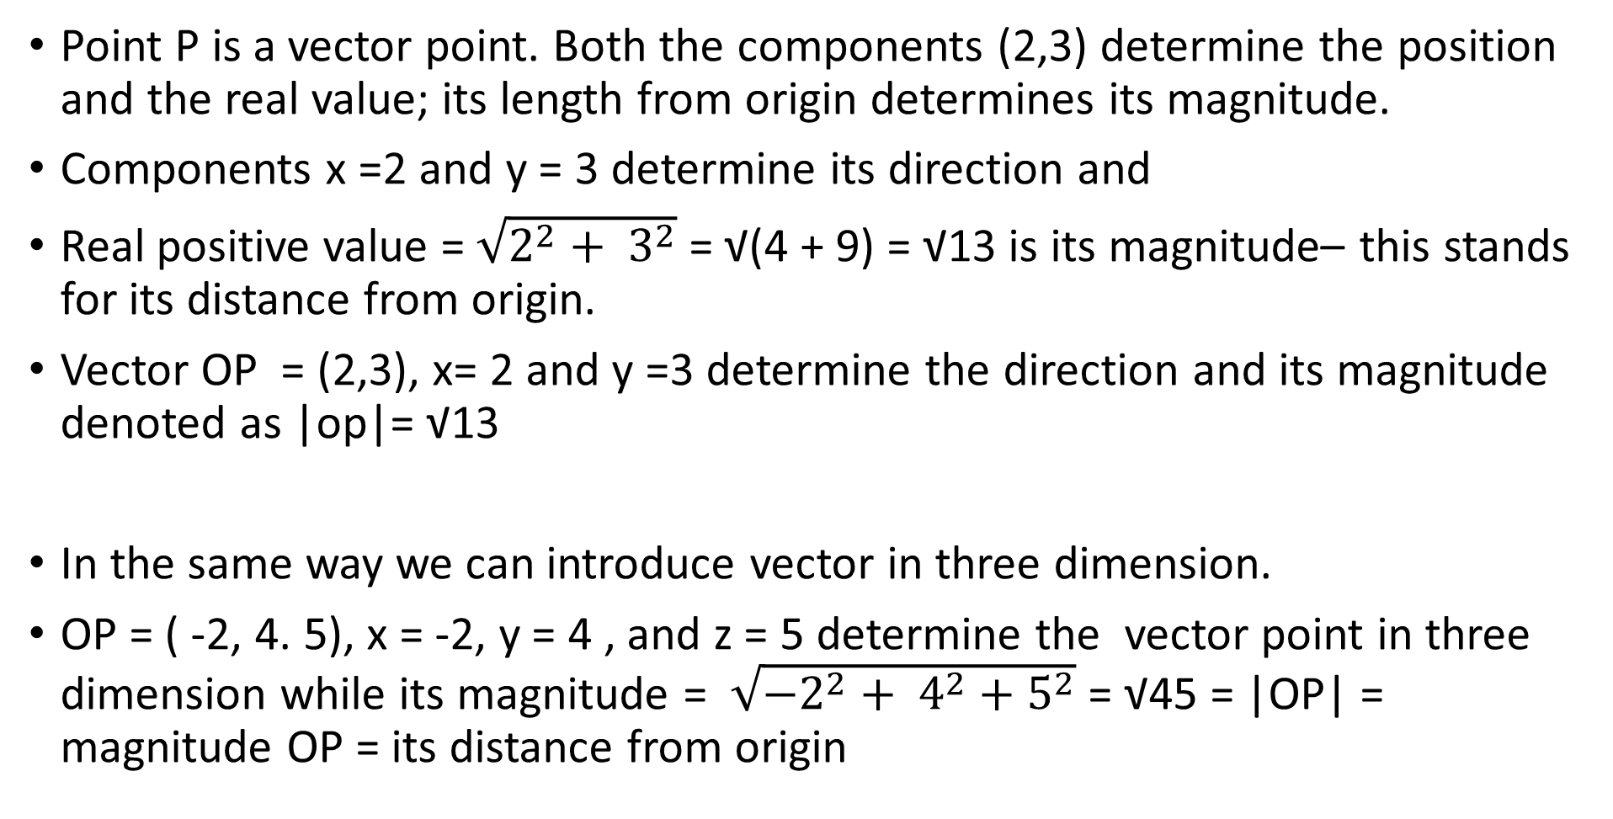
LALP.2
Point P is a vector point. Both the components (2,3) determine the position and the real value; its length from origin determines its magnitude.
Components x =2 and y = 3 determine its direction and
Real positive value = $\sqrt{2^{2}+ 3^{2}}$ = √(4 + 9) = √13 is its magnitude– this stands for its distance from origin.
Vector OP = (2,3), x= 2 and y =3 determine the direction and its magnitude denoted as |op|= √13
In the same way we can introduce vector in three dimension.
OP = ( -2, 4. 5), x = -2, y = 4 , and z = 5 determine the vector point in three dimension while its magnitude = $\sqrt{{−2}^{2}+ 4^{2}+5^{2}}$ = √45 = |OP| = magnitude OP = its distance from origin

Slide 4
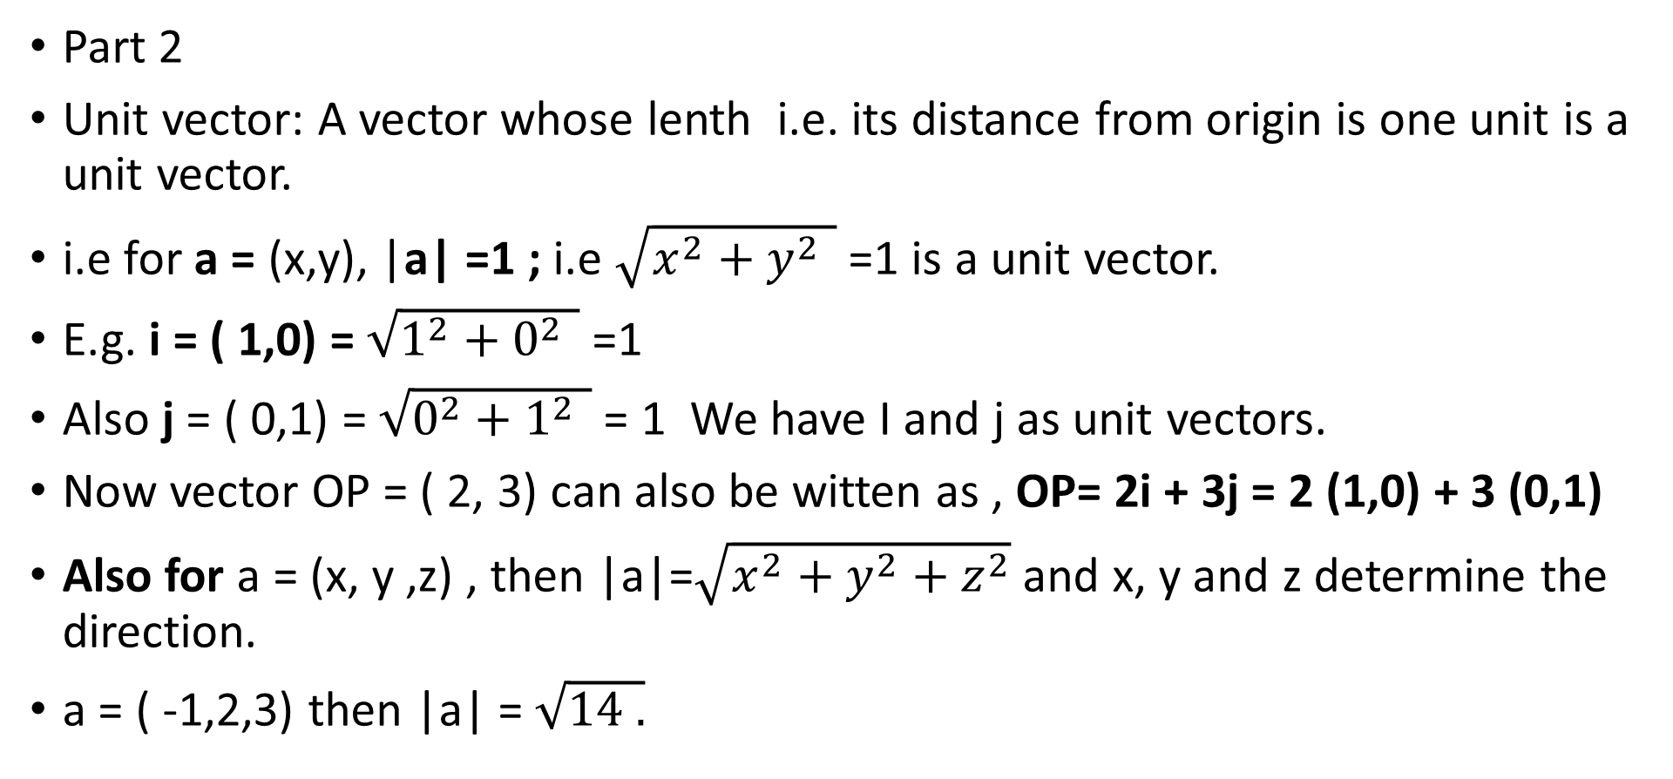
LALP-3
Part 2
Unit vector: A vector whose lenth i.e. its distance from origin is one unit is a unit vector.
i.e for a = (x,y), |a| =1 ; i.e $\sqrt{x^{2}+y^{2 }}$ =1 is a unit vector.
E.g. i = ( 1,0) = $\sqrt{1^{2}+0^{2 }}$ =1
Also j = ( 0,1) = $\sqrt{0^{2}+1^{2 }}$ = 1 We have I and j as unit vectors.
Now vector OP = ( 2, 3) can also be witten as , OP= 2i + 3j = 2 (1,0) + 3 (0,1)
Also for a = (x, y ,z) , then |a|=$\sqrt{x^{2}+y^{2}+z^{2}}$ and x, y and z determine the direction.
a = ( -1,2,3) then |a| = $\sqrt{14 .}$

Slide 5
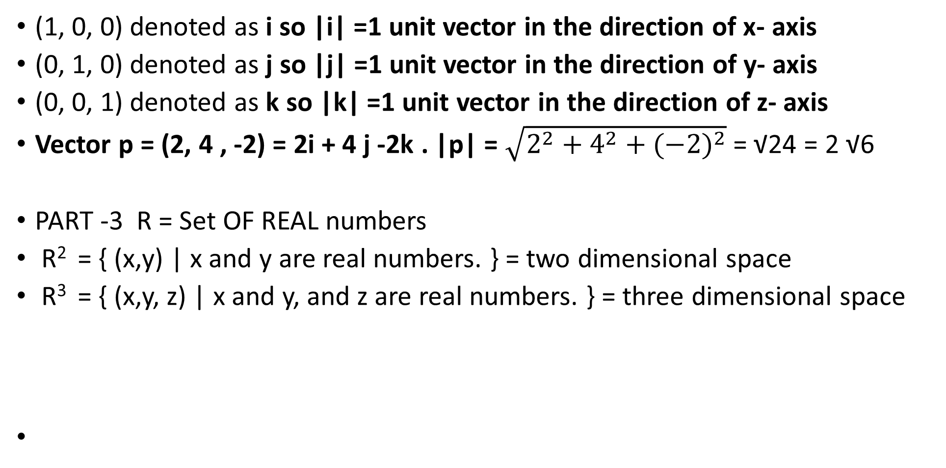
LALP-4
(1, 0, 0) denoted as i so |i| =1 unit vector in the direction of x- axis
(0, 1, 0) denoted as j so |j| =1 unit vector in the direction of y- axis
(0, 0, 1) denoted as k so |k| =1 unit vector in the direction of z- axis
Vector p = (2, 4 , -2) = 2i + 4 j -2k . |p| = $\sqrt{2^{2}+4^{2}+{(−2)}^{2}}$ = √24 = 2 √6
PART -3 R = Set OF REAL numbers
R² = { (x,y) | x and y are real numbers. } = two dimensional space
R³ = { (x,y, z) | x and y, and z are real numbers. } = three dimensional space

Slide 6
LALP-5
R² = two dimensional space { (x,y) | x and y are real numbers. }
y
j =(0,1) a = (x,y)
-x o i = (1,0) x |i|= |j| =1, I and j are unit vectors
-y

Slide 7
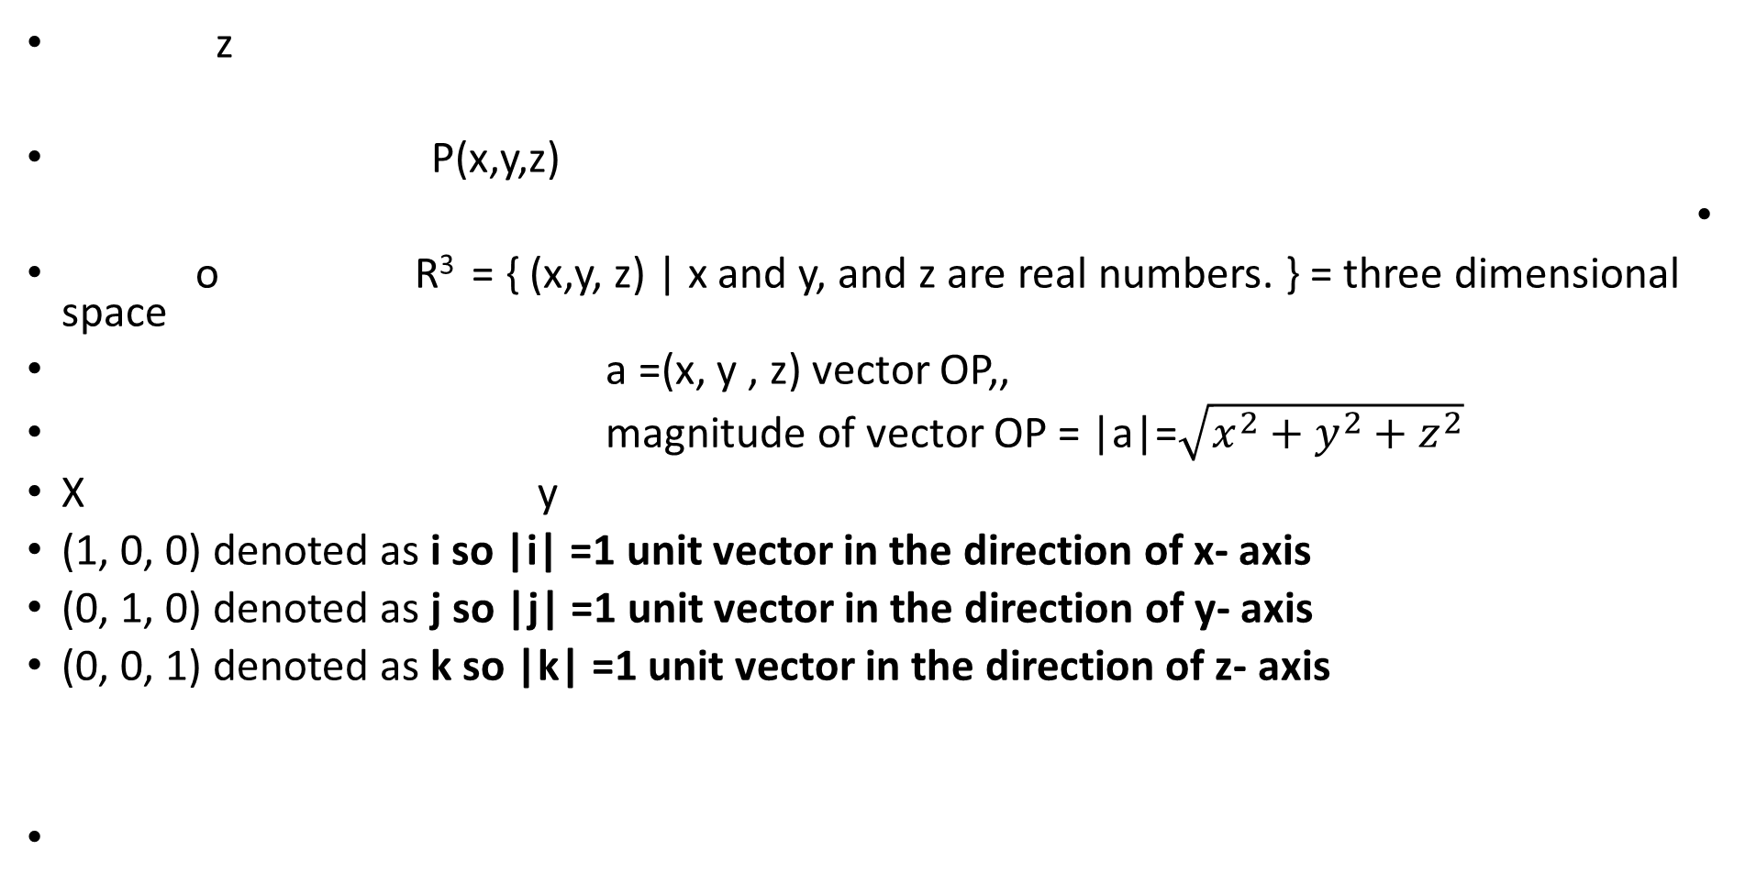
LALP -6
z
P(x,y,z)
o R³ = { (x,y, z) | x and y, and z are real numbers. } = three dimensional space
a =(x, y , z) vector OP,,
magnitude of vector OP = |a|=$\sqrt{x^{2}+y^{2}+z^{2}}$
X y
(1, 0, 0) denoted as i so |i| =1 unit vector in the direction of x- axis
(0, 1, 0) denoted as j so |j| =1 unit vector in the direction of y- axis
(0, 0, 1) denoted as k so |k| =1 unit vector in the direction of z- axis

Slide 8
LALP-7
Fundamentals:
1 Equality of two vectors of the same space, If P = ( x, y, z) Q = ( a, b, c)
P = Q corresponding components are equal.
i.e. x = a, y = b , and z = c and vice- versa
2 Addition of two vectors. : Addition of two vectors of the same space is also a vector.
P = ( x, y, z), Q = ( a, b, c) are the two ve ctors of R³ then their addition is also a vector.
P + Q = R = (x +a, y +b, z +c)
3 Multiplication by a scalar: Multilication of a vector y a scalar results in to a vector. For a eal value c, and a vector p = (x,y, z) , it is denoted as
Cp= c (x,y,z) = ( cx, cy, cz) e.g 5( -1, 2, 14) = ( -5, 10, 70)

Slide 9
LALP-8
Case: For x = (a,b) in R² or Y =(a,b,c) in R³ if the scalar; say k = 0 then
Kx = k(a,b) = 0( a,b) = (0,0) this is called a null vector denoted as O or ϴ.
ϴ = (0,0)----- a null vector with magnitude = 0
Ky= k(a,b, c) = 0( a,b,c ) = (0,0, 0) this is called a null vector denoted as O or ϴ.
ϴ = (0, 0, 0)----- a null vector in R³ with magnitude = 0

Slide 10
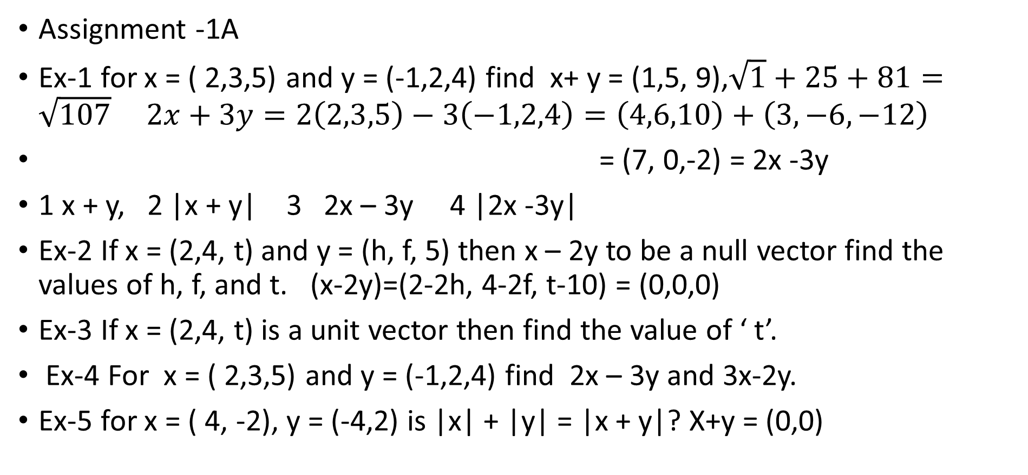
LALP-9
Assignment -1A
Ex-1 for x = ( 2,3,5) and y = (-1,2,4) find x+ y = (1,5, 9),$\sqrt{1}+25+81=\sqrt{107} 2x+3y=2\left(2,3,5\right)−3\left(−1,2,4\right)=\left(4,6,10\right)+\left(3,−6,−12\right)$
= (7, 0,-2) = 2x -3y
1 x + y, 2 |x + y| 3 2x – 3y 4 |2x -3y|
Ex-2 If x = (2,4, t) and y = (h, f, 5) then x – 2y to be a null vector find the values of h, f, and t. (x-2y)=(2-2h, 4-2f, t-10) = (0,0,0)
Ex-3 If x = (2,4, t) is a unit vector then find the value of ‘ t’.
Ex-4 For x = ( 2,3,5) and y = (-1,2,4) find 2x – 3y and 3x-2y.
Ex-5 for x = ( 4, -2), y = (-4,2) is |x| + |y| = |x + y|? X+y = (0,0)

Slide 11
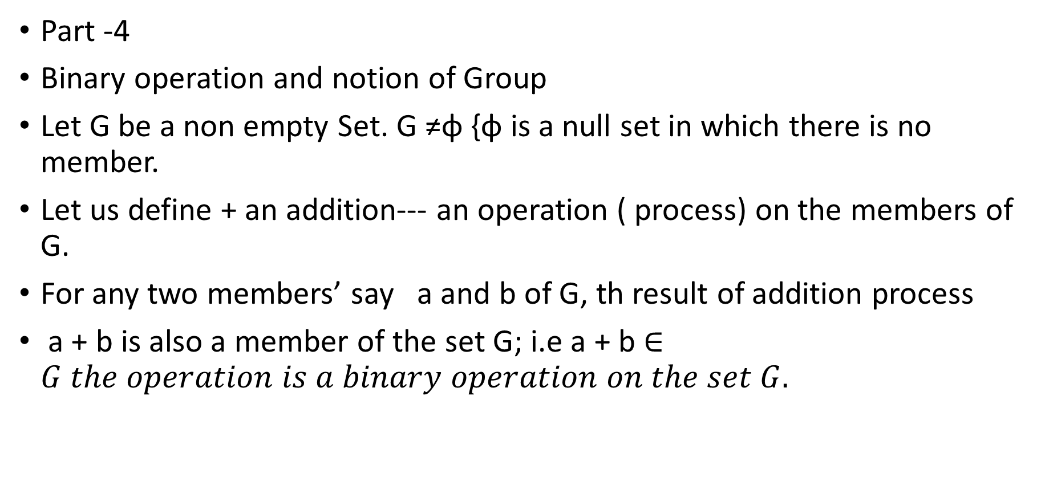
LALP-10
Part -4
Binary operation and notion of Group
Let G be a non empty Set. G ≠φ {φ is a null set in which there is no member.
Let us define + an addition--- an operation ( process) on the members of G.
For any two members’ say a and b of G, th result of addition process
a + b is also a member of the set G; i.e a + b $∈G the operation is a binary operation on the set G.$

Slide 12
LALP-11
The set R of real numbers and the continuing on the set R², R³ also follow some important properties that gives a structure of , what we call
‘ vector space’
1 Non empty set. 2 Two binary operations defined– generally + and .
3 + is commutative 4 + is associative, 5 existence of additive identity
7 existence of additive inverse
8 ‘.’ Is associative
9 existence of multiplicative identity
10 doubly distributive laws are satisfied a.(b+c) =a.b + a.c
(b +c).a =b.a +c.a
These are some important properties of vector space R, R², and R³

Slide 13
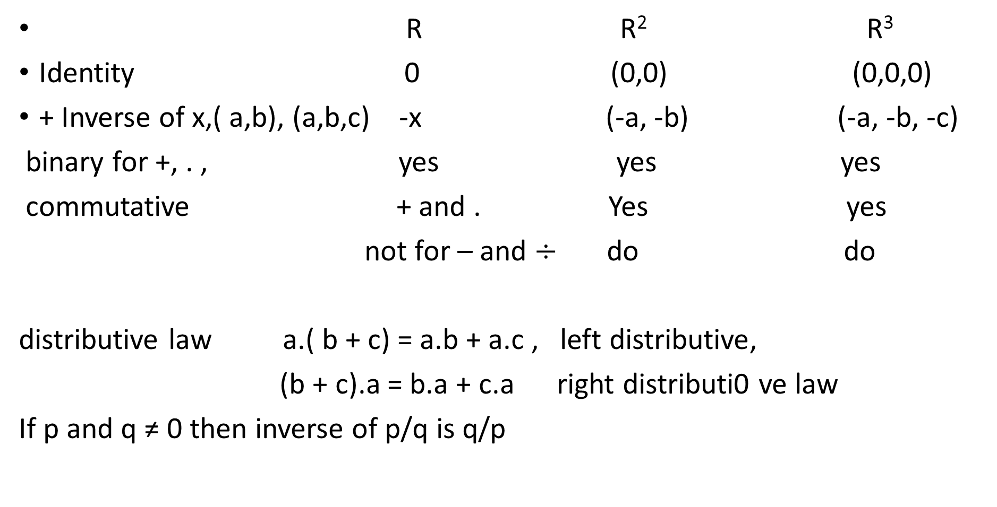
LALP-12
R R² R³
Identity 0 (0,0) (0,0,0)
+ Inverse of x,( a,b), (a,b,c) -x (-a, -b) (-a, -b, -c)
binary for +, . , yes yes yes
commutative + and . Yes yes
not for – and $÷$ do do
distributive law a.( b + c) = a.b + a.c , left distributive,
(b + c).a = b.a + c.a right distributi0 ve law
If p and q ≠ 0 then inverse of p/q is q/p

Slide 14
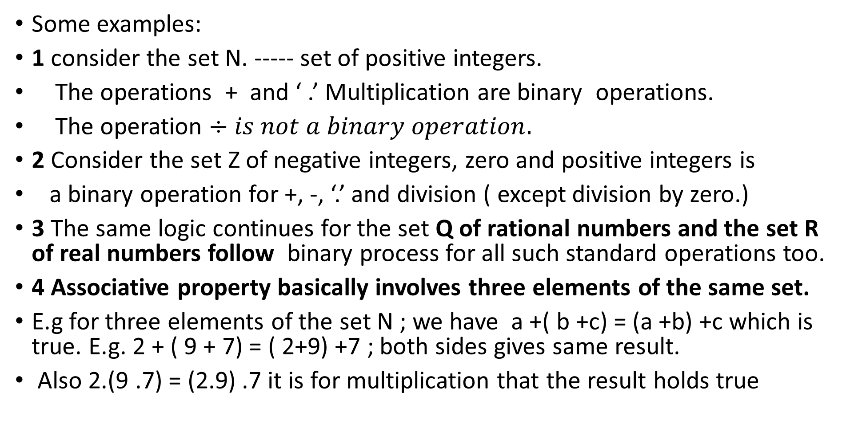
LALP-13
Some examples:
1 consider the set N. ----- set of positive integers.
The operations + and ‘ .’ Multiplication are binary operations.
The operation $÷is not a binary operation.$
2 Consider the set Z of negative integers, zero and positive integers is
a binary operation for +, -, ‘.’ and division ( except division by zero.)
3 The same logic continues for the set Q of rational numbers and the set R of real numbers follow binary process for all such standard operations too.
4 Associative property basically involves three elements of the same set.
E.g for three elements of the set N ; we have a +( b +c) = (a +b) +c which is true. E.g. 2 + ( 9 + 7) = ( 2+9) +7 ; both sides gives same result.
Also 2.(9 .7) = (2.9) .7 it is for multiplication that the result holds true

Slide 15
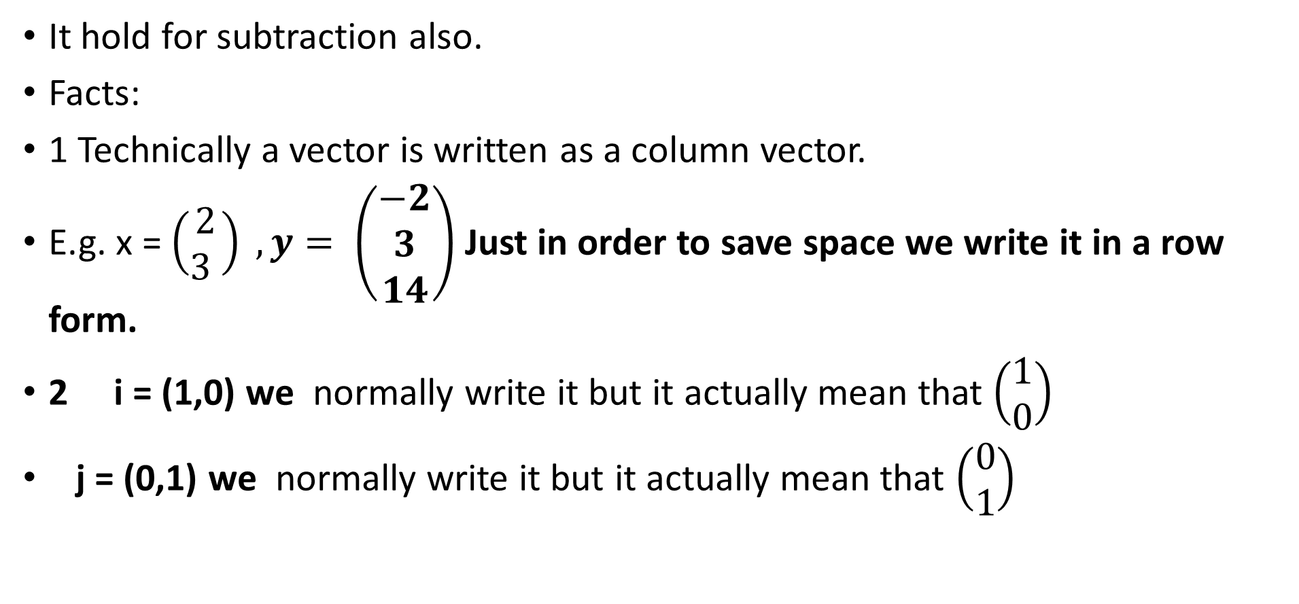
LALP 14
It hold for subtraction also.
Facts:
1 Technically a vector is written as a column vector.
E.g. x = $\left(\begin{matrix}2 \\ 3 \end{matrix}\right) , y= \left(\begin{matrix}−2 \\ 3 \\ 14\end{matrix}\right)$ Just in order to save space we write it in a row form.
2 i = (1,0) we normally write it but it actually mean that $\left(\begin{matrix}1 \\ 0\end{matrix}\right)$
j = (0,1) we normally write it but it actually mean that $\left(\begin{matrix}0 \\ 1\end{matrix}\right)$

Slide 16
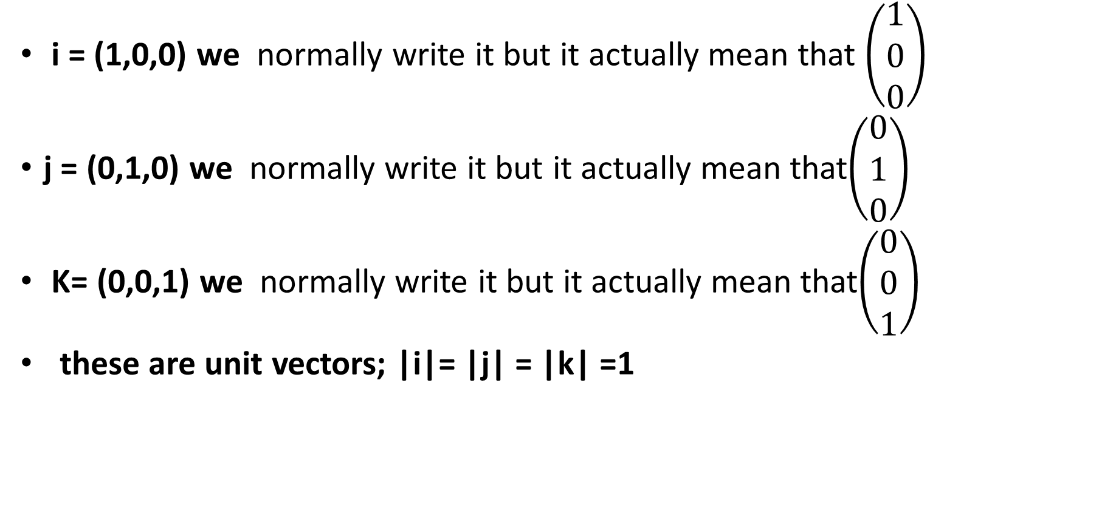
LALP 15
i = (1,0,0) we normally write it but it actually mean that $\left(\begin{matrix}1 \\ 0 \\ 0\end{matrix}\right)$
j = (0,1,0) we normally write it but it actually mean that$\left(\begin{matrix}0 \\ 1 \\ 0\end{matrix}\right)$
K= (0,0,1) we normally write it but it actually mean that$\left(\begin{matrix}0 \\ 0 \\ 1\end{matrix}\right)$
these are unit vectors; |i|= |j| = |k| =1

Slide 17
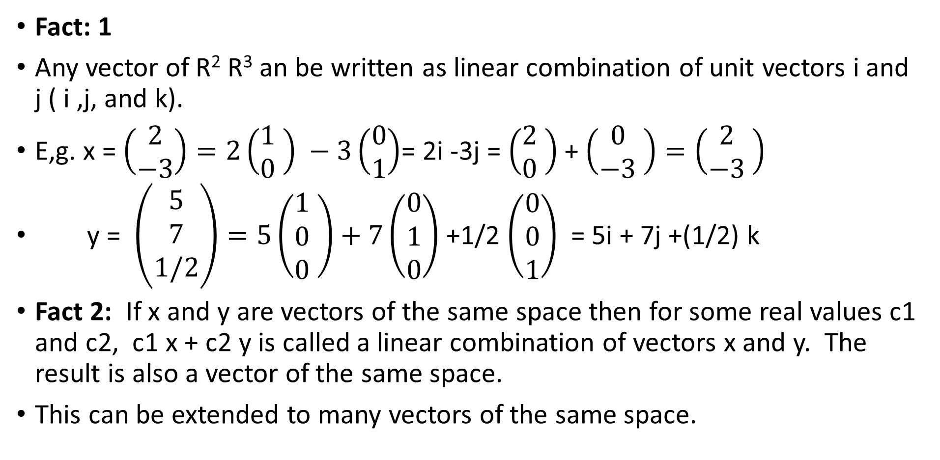
LALP 16
Fact: 1
Any vector of R² R³ an be written as linear combination of unit vectors i and j ( i ,j, and k).
E,g. x = $\left(\begin{matrix}2 \\ −3\end{matrix}\right)=2\left(\begin{matrix}1 \\ 0\end{matrix} \right) −3\left(\begin{matrix}0 \\ 1\end{matrix}\right)$= 2i -3j = $\left(\begin{matrix}2 \\ 0\end{matrix} \right)$+ $\left(\begin{matrix}0 \\ −3\end{matrix} \right)=\left(\begin{matrix}2 \\ −3\end{matrix} \right)$
y = $\left(\begin{matrix}5 \\ 7 \\ 1/2\end{matrix}\right)=5\left(\begin{matrix}1 \\ 0 \\ 0\end{matrix} \right)+7\left(\begin{matrix}0 \\ 1 \\ 0\end{matrix}\right)$ +1/2 $\left(\begin{matrix}0 \\ 0 \\ 1\end{matrix}\right)$ = 5i + 7j +(1/2) k
Fact 2: If x and y are vectors of the same space then for some real values c1 and c2, c1 x + c2 y is called a linear combination of vectors x and y. The result is also a vector of the same space.
This can be extended to many vectors of the same space.

Slide 18
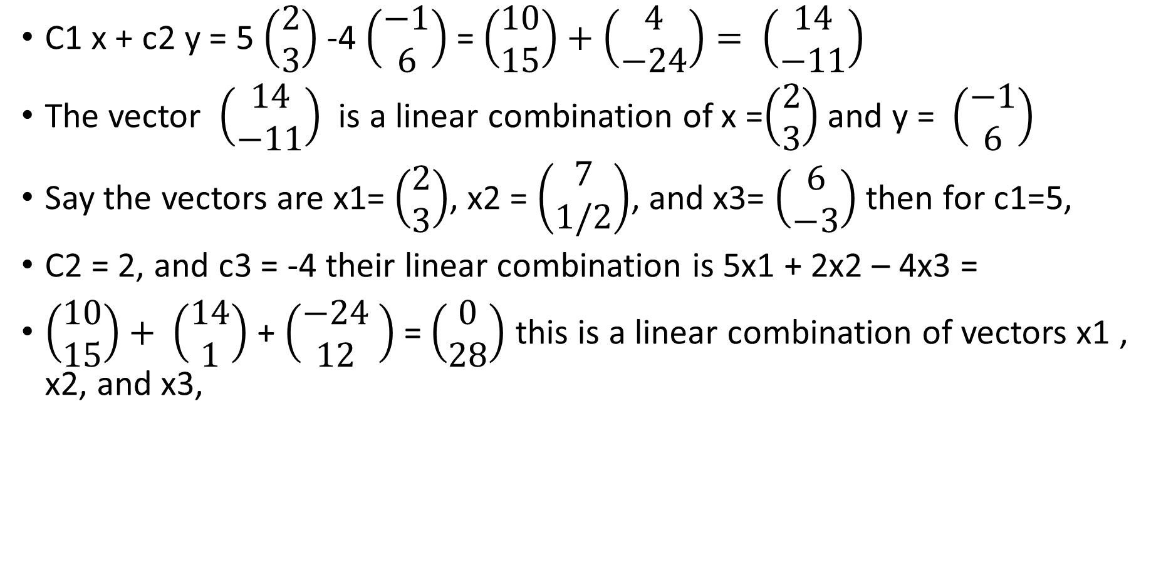
LALP-17
C1 x + c2 y = 5 $\left(\begin{matrix}2 \\ 3\end{matrix}\right)$-4 $\left(\begin{matrix}−1 \\ 6\end{matrix}\right)$= $\left(\begin{matrix}10 \\ 15\end{matrix}\right)+$ $\left(\begin{matrix}4 \\ −24\end{matrix}\right)= \left(\begin{matrix}14 \\ −11\end{matrix}\right)$
The vector $\left(\begin{matrix}14 \\ −11\end{matrix}\right)$ is a linear combination of x =$\left(\begin{matrix}2 \\ 3\end{matrix}\right)$ and y = $\left(\begin{matrix}−1 \\ 6\end{matrix}\right)$
Say the vectors are x1= $\left(\begin{matrix}2 \\ 3\end{matrix}\right)$, x2 = $\left(\begin{matrix}7 \\ 1/2\end{matrix}\right)$, and x3= $\left(\begin{matrix}6 \\ −3\end{matrix}\right)$ then for c1=5,
C2 = 2, and c3 = -4 their linear combination is 5x1 + 2x2 – 4x3 =
$\left(\begin{matrix}10 \\ 15\end{matrix}\right)+ \left(\begin{matrix}14 \\ 1\end{matrix}\right)$ + $\left(\begin{matrix}−24 \\ 12\end{matrix} \right)$ = $\left(\begin{matrix}0 \\ 28\end{matrix}\right)$ this is a linear combination of vectors x1 , x2, and x3,

Slide 19
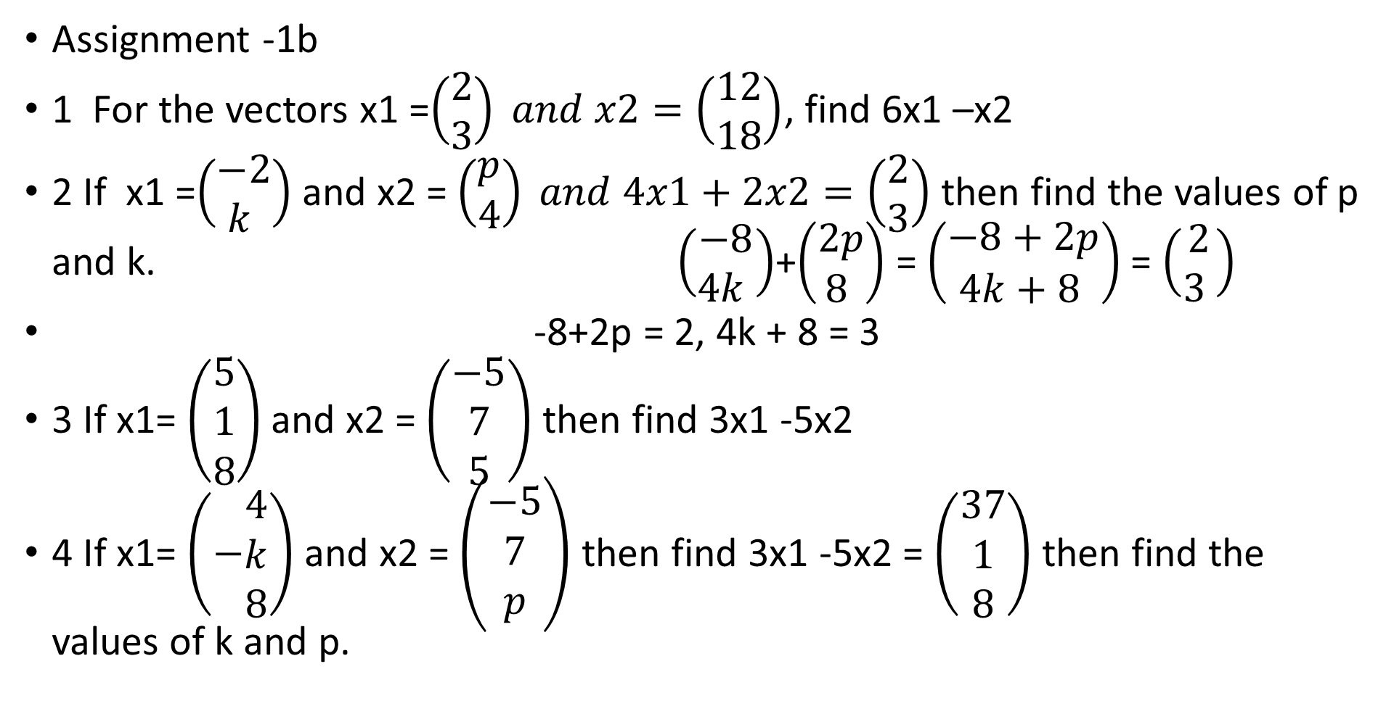
LALP-18
Assignment -1b
1 For the vectors x1 =$\left(\begin{matrix}2 \\ 3\end{matrix}\right) and x2=\left(\begin{matrix}12 \\ 18\end{matrix}\right)$, find 6x1 –x2
2 If x1 =$\left(\begin{matrix}−2 \\ k \end{matrix}\right)$and x2 = $\left(\begin{matrix}p \\ 4\end{matrix}\right) and 4x1+2x2=\left(\begin{matrix}2 \\ 3\end{matrix}\right)$ then find the values of p and k. $\left(\begin{matrix}−8 \\ 4k \end{matrix}\right)$+$\left(\begin{matrix}2p \\ 8 \end{matrix}\right)$ = $\left(\begin{matrix}−8+2p \\ 4k+8 \end{matrix}\right)$ = $\left(\begin{matrix}2 \\ 3 \end{matrix}\right)$
-8+2p = 2, 4k + 8 = 3
3 If x1= $\left(\begin{matrix}5 \\ 1 \\ 8\end{matrix}\right)$ and x2 = $\left(\begin{matrix}−5 \\ 7 \\ 5\end{matrix}\right)$ then find 3x1 -5x2
4 If x1= $\left(−\begin{matrix}4 \\ k \\ 8\end{matrix}\right)$ and x2 = $\left(\begin{matrix}−5 \\ 7 \\ p\end{matrix}\right)$ then find 3x1 -5x2 = $\left(\begin{matrix}37 \\ 1 \\ 8\end{matrix}\right)$ then find the values of k and p.

Slide 20
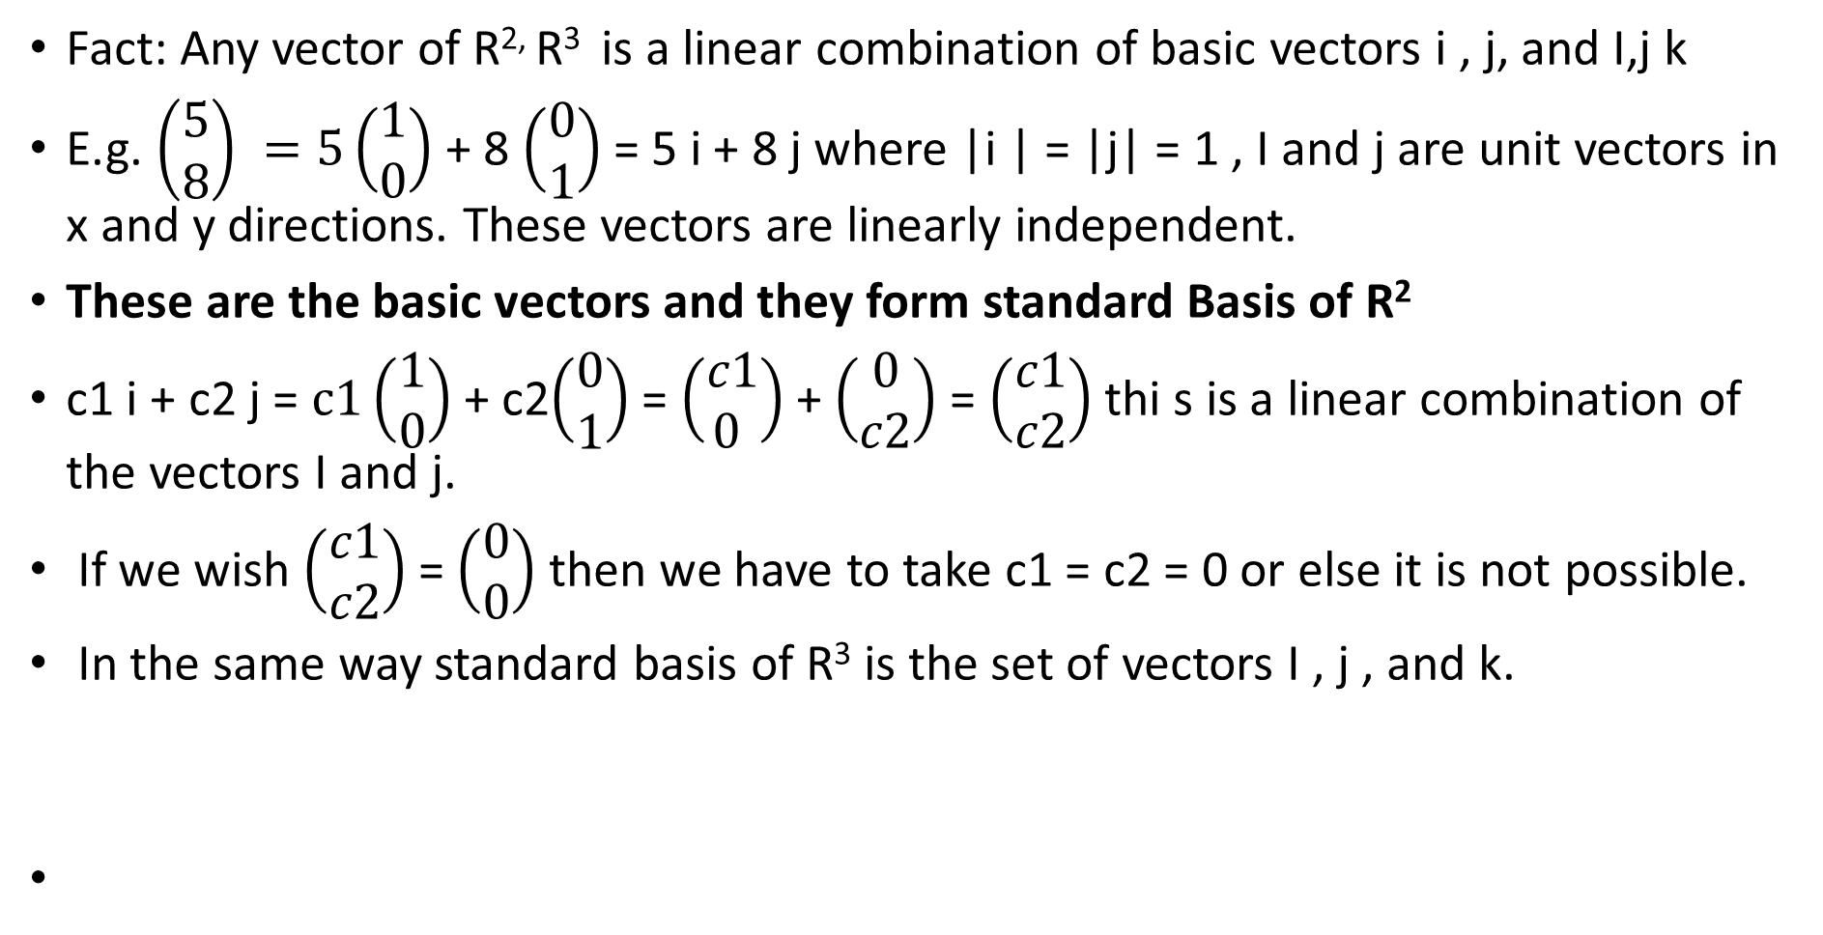
LALP-19
Fact: Any vector of R^{2,} R³ is a linear combination of basic vectors i , j, and I,j k
E.g. $\left(\begin{matrix}5 \\ 8\end{matrix}\right) =5\left(\begin{matrix}1 \\ 0\end{matrix}\right)$ + 8 $\left(\begin{matrix}0 \\ 1\end{matrix}\right)$= 5 i + 8 j where |i | = |j| = 1 , I and j are unit vectors in x and y directions. These vectors are linearly independent.
These are the basic vectors and they form standard Basis of R²
c1 i + c2 j = $c1\left(\begin{matrix}1 \\ 0\end{matrix}\right)$ + c2$\left(\begin{matrix}0 \\ 1\end{matrix}\right)$= $\left(\begin{matrix}c1 \\ 0 \end{matrix}\right)$ + $\left(\begin{matrix}0 \\ c2\end{matrix}\right)$= $\left(\begin{matrix}c1 \\ c2\end{matrix}\right)$ thi s is a linear combination of the vectors I and j.
If we wish $\left(\begin{matrix}c1 \\ c2\end{matrix}\right)$ = $\left(\begin{matrix}0 \\ 0\end{matrix}\right)$ then we have to take c1 = c2 = 0 or else it is not possible.
In the same way standard basis of R³ is the set of vectors I , j , and k.

Slide 21
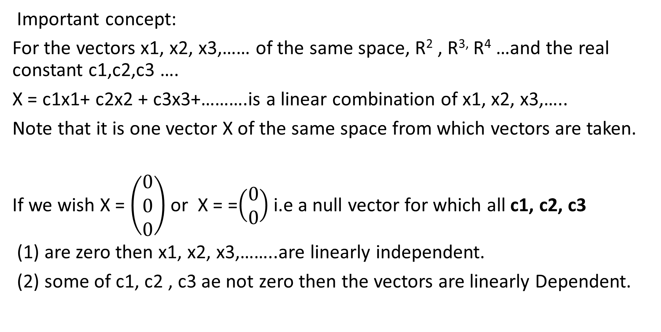
LALP-20
Important concept:
For the vectors x1, x2, x3,…… of the same space, R² , R^{3,} R⁴ …and the real constant c1,c2,c3 ….
X = c1x1+ c2x2 + c3x3+……….is a linear combination of x1, x2, x3,…..
Note that it is one vector X of the same space from which vectors are taken.
If we wish X = $\left(\begin{matrix}0 \\ 0 \\ 0\end{matrix}\right)$ or X = =$\left(\begin{matrix}0 \\ 0\end{matrix}\right)$ i.e a null vector for which all c1, c2, c3
(1) are zero then x1, x2, x3,……..are linearly independent.
(2) some of c1, c2 , c3 ae not zero then the vectors are linearly Dependent.

Slide 22
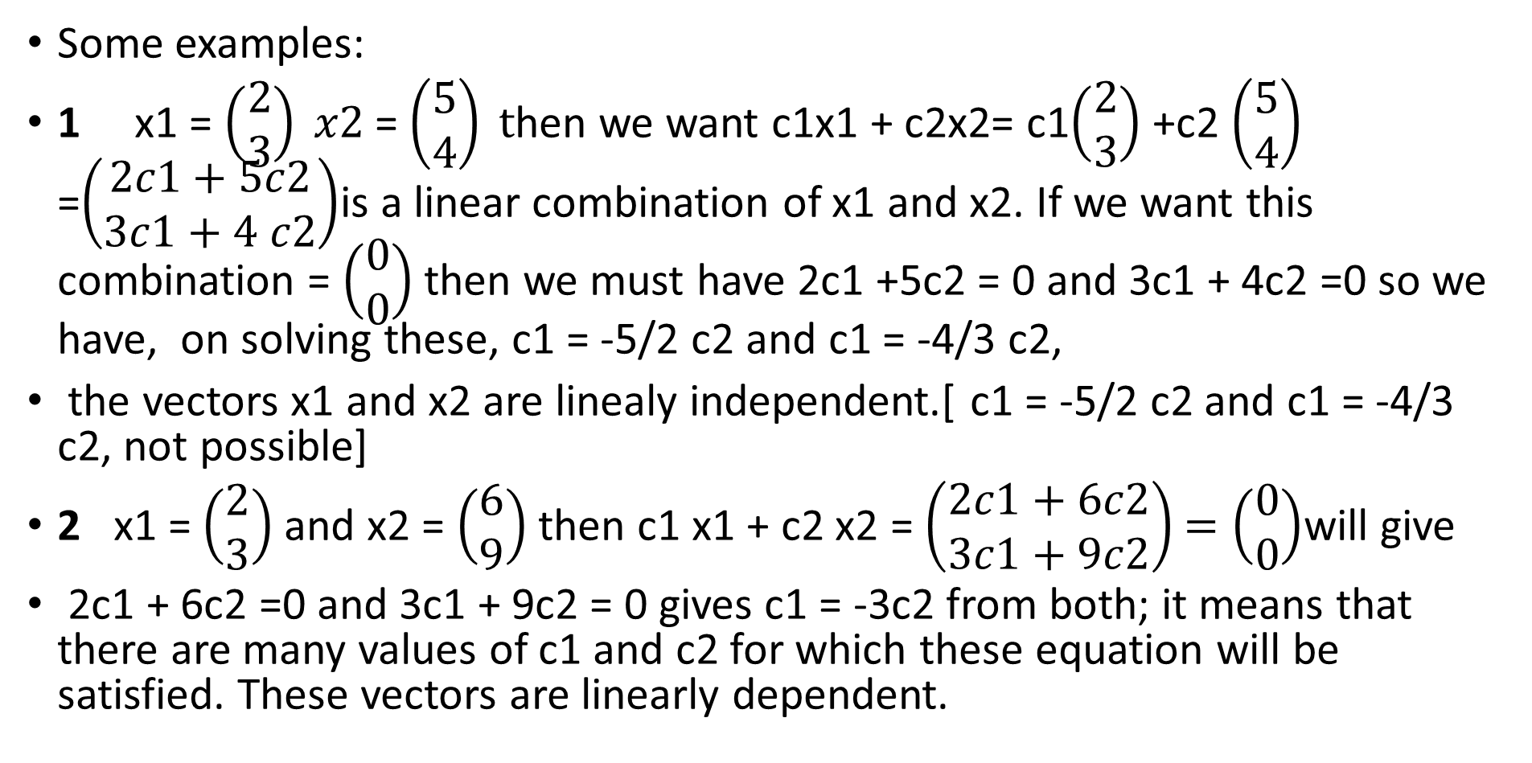
LALP-21
Some examples:
1 x1 = $\left(\begin{matrix}2 \\ 3\end{matrix}\right) x2$= $\left(\begin{matrix}5 \\ 4\end{matrix}\right) t$hen we want c1x1 + c2x2= c1$\left(\begin{matrix}2 \\ 3\end{matrix}\right)$ +c2 $\left(\begin{matrix}5 \\ 4\end{matrix}\right)$ =$\left(\begin{matrix}2c1+5c2 \\ 3c1+4 c2\end{matrix}\right)$is a linear combination of x1 and x2. If we want this combination = $\left(\begin{matrix}0 \\ 0\end{matrix}\right)$ then we must have 2c1 +5c2 = 0 and 3c1 + 4c2 =0 so we have, on solving these, c1 = -5/2 c2 and c1 = -4/3 c2,
the vectors x1 and x2 are linealy independent.[ c1 = -5/2 c2 and c1 = -4/3 c2, not possible]
2 x1 = $\left(\begin{matrix}2 \\ 3\end{matrix}\right)$ and x2 = $\left(\begin{matrix}6 \\ 9\end{matrix}\right)$ then c1 x1 + c2 x2 = $\left(\begin{matrix}2c1+6c2 \\ 3c1+9c2\end{matrix}\right)$ $=\left(\begin{matrix}0 \\ 0\end{matrix}\right)$will give
2c1 + 6c2 =0 and 3c1 + 9c2 = 0 gives c1 = -3c2 from both; it means that there are many values of c1 and c2 for which these equation will be satisfied. These vectors are linearly dependent.

Slide 23
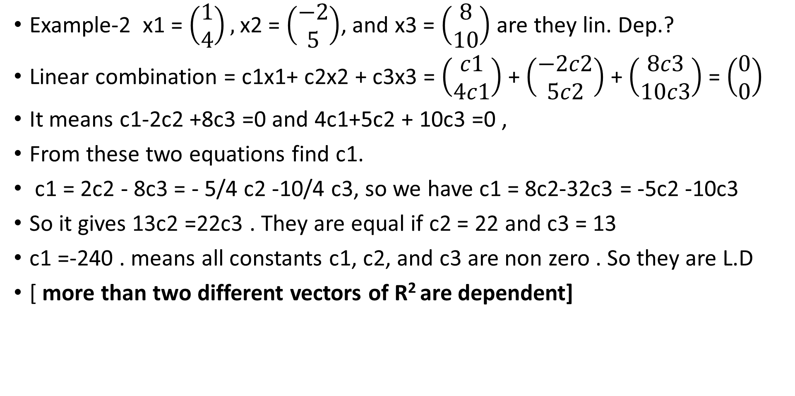
LALP -22
Example-2 x1 = $\left(\begin{matrix}1 \\ 4\end{matrix}\right),$x2 = $\left(\begin{matrix}−2 \\ 5\end{matrix}\right)$, and x3 = $\left(\begin{matrix}8 \\ 10\end{matrix}\right)$ are they lin. Dep.?
Linear combination = c1x1+ c2x2 + c3x3 = $\left(\begin{matrix}c1 \\ 4c1\end{matrix}\right)$ + $\left(\begin{matrix}−2c2 \\ 5c2\end{matrix}\right)$ + $\left(\begin{matrix}8c3 \\ 10c3\end{matrix}\right)$ = $\left(\begin{matrix}0 \\ 0\end{matrix}\right)$
It means c1-2c2 +8c3 =0 and 4c1+5c2 + 10c3 =0 ,
From these two equations find c1.
c1 = 2c2 - 8c3 = - 5/4 c2 -10/4 c3, so we have c1 = 8c2-32c3 = -5c2 -10c3
So it gives 13c2 =22c3 . They are equal if c2 = 22 and c3 = 13
c1 =-240 . means all constants c1, c2, and c3 are non zero . So they are L.D
[ more than two different vectors of R² are dependent]

Slide 24
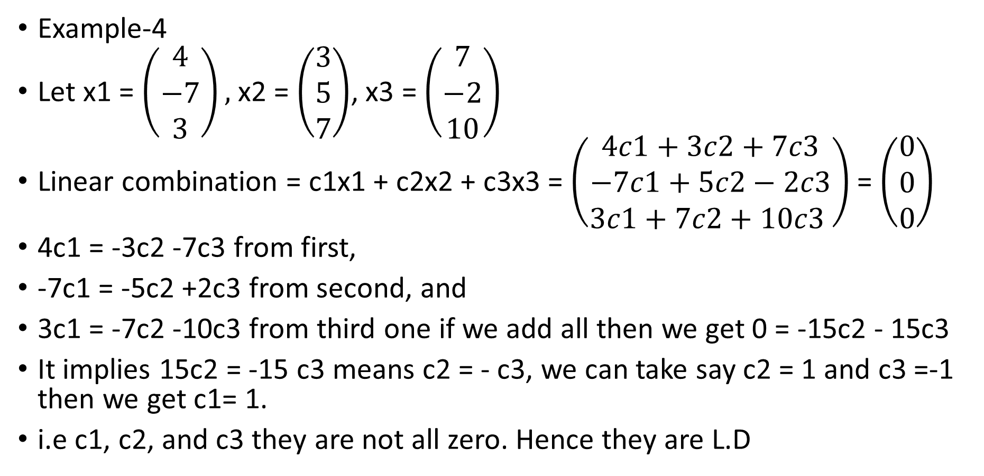
LALP-23
Example-4
Let x1 = $\left(\begin{matrix}4 \\ −7 \\ 3\end{matrix}\right),$ x2 = $\left(\begin{matrix}3 \\ 5 \\ 7\end{matrix}\right)$, x3 = $\left(\begin{matrix}7 \\ −2 \\ 10\end{matrix}\right)$
Linear combination = c1x1 + c2x2 + c3x3 = $\left(\begin{matrix}4c1+3c2+7c3 \\ −7c1+5c2−2c3 \\ 3c1+7c2+10c3 \end{matrix}\right)$ = $\left(\begin{matrix}0 \\ 0 \\ 0\end{matrix}\right)$
4c1 = -3c2 -7c3 from first,
-7c1 = -5c2 +2c3 from second, and
3c1 = -7c2 -10c3 from third one if we add all then we get 0 = -15c2 - 15c3
It implies 15c2 = -15 c3 means c2 = - c3, we can take say c2 = 1 and c3 =-1 then we get c1= 1.
i.e c1, c2, and c3 they are not all zero. Hence they are L.D

Slide 25
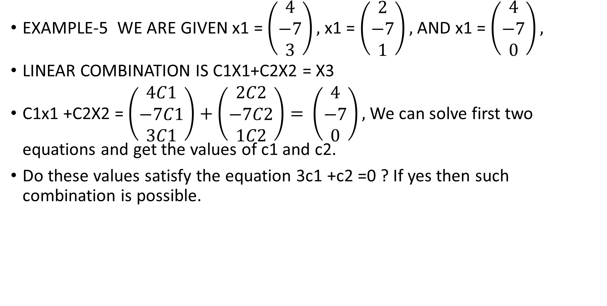
LALP-24
EXAMPLE-5 WE ARE GIVEN x1 = $\left(\begin{matrix}4 \\ −7 \\ 3\end{matrix}\right),$ x1 = $\left(\begin{matrix}2 \\ −7 \\ 1\end{matrix}\right),$ AND x1 = $\left(\begin{matrix}4 \\ −7 \\ 0\end{matrix}\right),$
LINEAR COMBINATION IS C1X1+C2X2 = X3
C1x1 +C2X2 = $\left(\begin{matrix}4C1 \\ −7C1 \\ 3C1\end{matrix}\right)+\left(\begin{matrix}2C2 \\ −7C2 \\ 1C2\end{matrix}\right)=$ $\left(\begin{matrix}4 \\ −7 \\ 0\end{matrix}\right),$ We can solve first two equations and get the values of c1 and c2.
Do these values satisfy the equation 3c1 +c2 =0 ? If yes then such combination is possible.

Slide 26
LALP-25
Assignment -3
(a) Explain linear dependent and independent vectors and check the following vectors for dependency
(a.1) x1 = ( 2, 3), and x2 = ( 4,6) (a.2) x1 = (-1, 5) and x2 = ( 7, 4)
(a.3) y1 = (1,0) and y2 =(0,1) (a.4) x1 = (4,2,2) and x2 = ( 4, 2,1)
{ Note: If the vectors are linearly dependent the any one of them is a linear combination of the remaining vecors; if not possible then they are linearly independent}
(b) check for dependency
(b-1) x1 = ( 2,3,4), x2 = ( 3,4,5) and x3 = (5, 7, 9)
(b.2) x1 = ( 7, 1, 0) x2 = ( 4, 6, 8) and x3 = (10, 7, 7)

Slide 27
LALP-26
Transformations: We have the vector space R, R², and R³. Our idea is to move from one space to another space or mutual travel within the space. This journey is called ‘Transformation’. We, can, using proper tool of function, move from R to R², and R³. Also we can, using proper tool , can go come back from one space other higher spaces also.
E.g. T : R R, T : R R², T : R R^{3,}
T : R² R³, T : R³ R^{3,} T : R³ R² etc.
But moving must conform from the laws of one space to where we want to go.
E.g. T : R² R³ . WE know that in r² there are ordered pairs like (x,y) and in R³ there are ordered triplets like (x,y,z). Also do not forget that members of R², and R³ are column vectors but we write it as rowwise.

Slide 28
LALP-27
T : R² R³ , For (a,b) in R² ^{thee} result of application of T, written as T(,b)
We design a rule, ( GHAR KA RULE), say T ( a,b) = ( a+b, a-b, a+2b). Let us understand it by an example.
Say ( a,b) = (2, 3) then T(2,3) = (2+3, 2-3, 2+ 2.(3)) = (5,-1,8)
So under the said transformation, the vector (2,3) of R² is transferred to the vector (5,-1,8)
Some more illustrations; 1 T: R² R^{2,} for (a,b) of R² T ( a,b) = ( a-b, a)
Then t(3, -5) = ( 3-(-5), 3) = (8,3)
2 T: R³ R² for (a,b,c) of R³ T(a,b,c)= (a+c, b-c) ,T(2,-4, 3)= (2+3, 4-3)= (5,1)
3 T: R³ R², for (a,b,c) of R³ T(a,b,c)= (a² , c+ b²) ,T(2,-4, 3)= (4, 3+16)=
(4,19)

Slide 29
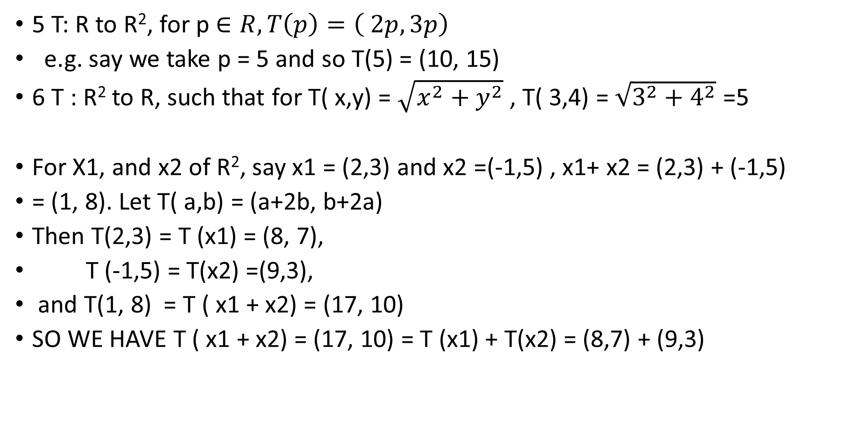
LALP-28
5 T: R to R², for p $∈R, T\left(p\right)=\left( 2p, 3p\right)$
e.g. say we take p = 5 and so T(5) = (10, 15)
6 T : R² to R, such that for T( x,y) = $\sqrt{x^{2}+y^{2}}$ , T( 3,4) = $\sqrt{3^{2}+4^{2}}$ =5
For X1, and x2 of R², say x1 = (2,3) and x2 =(-1,5) , x1+ x2 = (2,3) + (-1,5)
= (1, 8). Let T( a,b) = (a+2b, b+2a)
Then T(2,3) = T (x1) = (8, 7),
T (-1,5) = T(x2) =(9,3),
and T(1, 8) = T ( x1 + x2) = (17, 10)
SO WE HAVE T ( x1 + x2) = (17, 10) = T (x1) + T(x2) = (8,7) + (9,3)

Slide 30
LALP PART -2
Dr. Pradeep.J.Jha

Slide 31
LALP PART 2.1
Subspace:
Let V be space of a vector space. Let + and . Be the two binary operations defined on it. Let V be defined on the set R of real numbers. Let S be a subset of V. If the set S itself is a vector space itself. In this case the set ‘S’ is called a subspace of V.
A non-empty subset S of the vector space V. is a subspace of V if and only if the following conditions are satisfied. (1) for x, and y of S , x + y is also in S. and (2) for x of S, and $∝any real number , we have$ $∝$x also in S.
The set S = {ϴ } and S = V, both are also subspace of V. These are called improper subspace of V.
Illustation-1 Let U1= { (a1,a2,a3)| a1-2a2+a3 = 0 }, is it a subpaceof R³ ?
a1, a2, and a3 are real numbers.

Slide 32
LALP PART 2.3
Facts:
1 That two vectors of R² can be linearly independent or dependent. This
depends on condition of independency or dependency. S1= { (1,2), (3,4) },
S2 ={(1,0), (0,1)}, S3 = { (3,-4), (2,6), S4 ={ (5, 15), (1,3)}, which are L.D ?
More than two diferent vectors of R² are linearly dependent if any two of them are linearly independent. E.g. { (1,2), (3,4), (1,7)} are linearly dependent as any two of them are linearly independent. S2 = { (3,4) ,(2,4) , (5,-7)} are linearly dependent[(3,4) = c1(2,4) + c2 (5,-7) ; we can find c1 and c2 which are other than zero.
In the same way we can state for the vectors of R³.
A Basis is a set of basic vectors. Standard basic vectors are { (1,0), (0,1)}
(6,8) = 6(1,0) + 8 (0,1)= 6i + 8j, |i| = |j| =1

Slide 33
LALP PART 2.2
For x1, and x2 of u1 and $∝and$ $β$ numbers linear combination
$∝$x1 + $β$x2 = {$∝($a1,a2,a3) + $β$(y1, y2,y3)} has property that
$∝$ (a1-2a2+a3) =0 and $β$ ( y1- 2y2+y3 ) = 0 given property
{$∝($a1,a2,a3) + $β$(y1, y2,y3)} = { ($∝$a1 ,$∝a2,∝$a3) + ($β$y1 , $β$y2, $β$y3)}
{ ($∝$a1 + $β$y1, $∝a2$+ $β$y2 , $∝$a3 + $β$y3)} has the same poperty that
$∝$a1 + $β$y1 – 2 ($∝a2$+ $β$y2) + $∝$a3 + $β$y3 =0 whch is always true as it can be written as $∝$ (a1-2a2+a3) + $β$ ( y1- 2y2+y3 ) = $∝$(0) + $β$(0) = 0 +0 = 0
Hence the set u1 with the given poperty is a subspace of R³ = 0

Slide 34
LALP PART 2.4
Facts
4: Any two L. independent vectors of R² form a basis of R² Any other vector of
R² can be represented by linear combination of these two vectors.
S1 = {(2,5), ( 1,4)} ; these are linearly indep. Say there is a vector (-2,7) of R²
Now, (-2,7) = c1(2,5) + c2(1,4) and so -2 = 2c1 + 1c2, 7 = 5c1 + 4c2, We can solve these two equations for non zero c1 and c2.
It means that any vector of R² can be constructed with these two vectors of S1.
S1 is a basis. The set , denoted as B1= { (1,0) , (0,1)} is a basis– standard basis of R^{2.}
5 : Linear Span: The set of all possible combinations like $∝$x1 + $β$x2 or
$∝$x + $βy for∝\text{, }\text{and} β as real numbers is called a linear span$.
This is denoted as [s].

Slide 35
LALP 2.5
Vectors of the basis are called basic vectors. One can obtain any vector of R² or R³
B2= { (1,0,0) , (0,1,0), ( 0,0,1)} is a standard basis of R³.
(p,q,r) = p (1,0,0) + q (0,1,0) + r(0,0,1) for real values p,q and r.
Remember that vectors of basis are
(1) linearly independent
(2) They span the given vector space.
Example: Show that the vector (1,2,3)belongs to [(2,1,0),(3,0,1), (-2,5,0)]
But does not belong to {(2,1,0),(-2,-1,0),(-2,5,0)}
(1,2,3) $∈$ $α\text{(2,1,0)}$ +$β\text{(3,0,1)}$ +$γ\text{(−2,5,0)}$ ; find $α$, $β$, and $γ [α$ =9/2, $β=−3$, and $γ$ =-1/2]

Slide 36
LALP 2.6
Prove that (1,2,3) $∉ ∝$(2,1,0) + $β$(-2, -1,0) + $γ$(2,5,0)
[ D = $\left\lfloor \begin{matrix}2 \\ 1 \\ 0\end{matrix} \begin{matrix}−2 \\ −1 \\ 0\end{matrix} \begin{matrix}2 \\ 5 \\ 0\end{matrix}\right\rfloor$ = 0 implies that the vectors are L.D. They cannot span the space.]
A non-empty subset B of a vector space V is a basis of V if each vector of V can be uniquely expressed as a linear combination of vectors of V in a unique way.
A subset B1 of vector space V, which properly contains B, then vectors of B1 are linearly dependent.
Say B = { (1,4), (-2,5)} ---- Is it a basis? Linearly ind. And span R².
B1 = { (1,4), (2,5), (5,-2)} i.e.
B $⊏B1 It means that vectors of B1 are l.d.$

Slide 37
LALP 2.7
Dimension:
Dimension of a vector space is the number that shows number of vectors in basis. Basis of R² has two vectors in the basis and hence dimension of R² is 2. In the same way dimension of R³ is = 3.
These are finite dimensional vector spaces.
Is the set { (1,4), (2,5), (1,7),(2,8)} of vectors linearly dependent? Explain.
The set of all 2x2 matrices has the rank 4.
Basis of M2, the set of all 2x2 matrices has the basis = { $\left[\begin{matrix}1 & 0 \\ 0 & 0\end{matrix}\right]$, $\left[\begin{matrix}0 & 1 \\ 0 & 0\end{matrix}\right]$, $\left[\begin{matrix}0 & 0 \\ 1 & 0\end{matrix}\right]$, $\left[\begin{matrix}0 & 0 \\ 0 & 1\end{matrix}\right]$}
Any matrix $\left[\begin{matrix}a & b \\ c & d\end{matrix}\right]$ is a linear combination of vectors in the basis.
a $\left[\begin{matrix}1 & 0 \\ 0 & 0\end{matrix}\right]$ + b $\left[\begin{matrix}0 & 1 \\ 0 & 0\end{matrix}\right]$ + c $\left[\begin{matrix}0 & 0 \\ 1 & 0\end{matrix}\right]$ + d $\left[\begin{matrix}0 & 0 \\ 0 & 1\end{matrix}\right]$ = $\left[\begin{matrix}a & b \\ c & d\end{matrix}\right]$ ,
(,

Slide 38
LALP 2.8
In the same way the vector space M₃ _{of} all 3x3 matrices have 9 elements( matrices ) in its basis. E.g. the matrix $\left[\begin{matrix}1 & 0 & 0 \\ 0 & 0 & 0 \\ 0 & 0 & 0\end{matrix}\right]$
Out of 9 entries one is 1 and others are zero. Any matrix of the space M₃ is a linear combination of all this nine matrices of the basis.
We can continue for higher dimensional spaces.

Slide 39
LALP 2.9
Back to L.T.
A transformation from one vector space U to the another vector space V, denoted as T: U V is called linear if for
X1 and x2 as members of U and c1 and c2 as constants, we have either
1 T(x1 + x2) = T(x1) + T (x2)
2 T (c1x1) = c1 T( x1)
or
T( c1x1 + c2x2) = c1T(x1) + c2 T(x2)
Illustration: Let T: R² R² so that for (a,b) of R² T(a,b) = ( 2a +b, a-b)

Slide 40
LALP 2.10
Let a = (x1,x2) = (2,5) and so T(a) = T(x1,x2) = T(2.2 +5, 2-5) = (9,-3)
Let b = (y1,y2) = (-2, 6) and so T(b) = T(y1,y2) =T(2. -2 +6 , -2-6) = (2,-8)
T(a) + T(b) = (9,-3)+(2,-8) = (11, -11)
T(a +b) = T( (x1,x2) + (y1, y2)) = T ( (2,5) + (-2,6)) = T(0,11) = (2.0+11, 0-11)
T(a + b) = (11,-11)
T(a+b) = T(a) + T(b) ………………..(1)
For some real value c let us find T(ca) = T( c(x1, x2)) = T(c(2,5)) = T( 2c, 5c)
= (2. (2c) + 5c, 2c- 5c) = (9c, -3c) = c( 9, -3) = c T(a)
$∴$ T(ca) = c T(a) ……………………..(2)
$∴$ It is a linear transformation.

Slide 41
LALP 2.11
1 Consider T : R ² R² defined as T( x, y) = (y, x)
a= (x1,y1) and b = (x2,y2), $∴$ T(a) = T(x1,y1) = (y1,x1),
T(b) = T (x2,y2) = (y2,x2)
$∴$ T(a) + T(b) = (y1,x1) + (y2 , x2) = (y1+y2, x1+x2) ……………. (1)
We find T(a+b) = T((x1,y1)+ (x2,y2)) = T(x1+x2, y1+y2) = (y1+y2, x1+x2)…..(2)
For some c, T(ca) = T(c(x1,y1)0 = T (cx1, cy1) = (cy1. cx1) = c( y1,x1) = cT(a)
$∴$ T(ca) = c(T(a) ..(3)
$∴$ It is a linear transformation. It is reflection about the line y = x.
In the same way T(x,y) = (y, -x) is a reflexion about y = -x

Slide 42
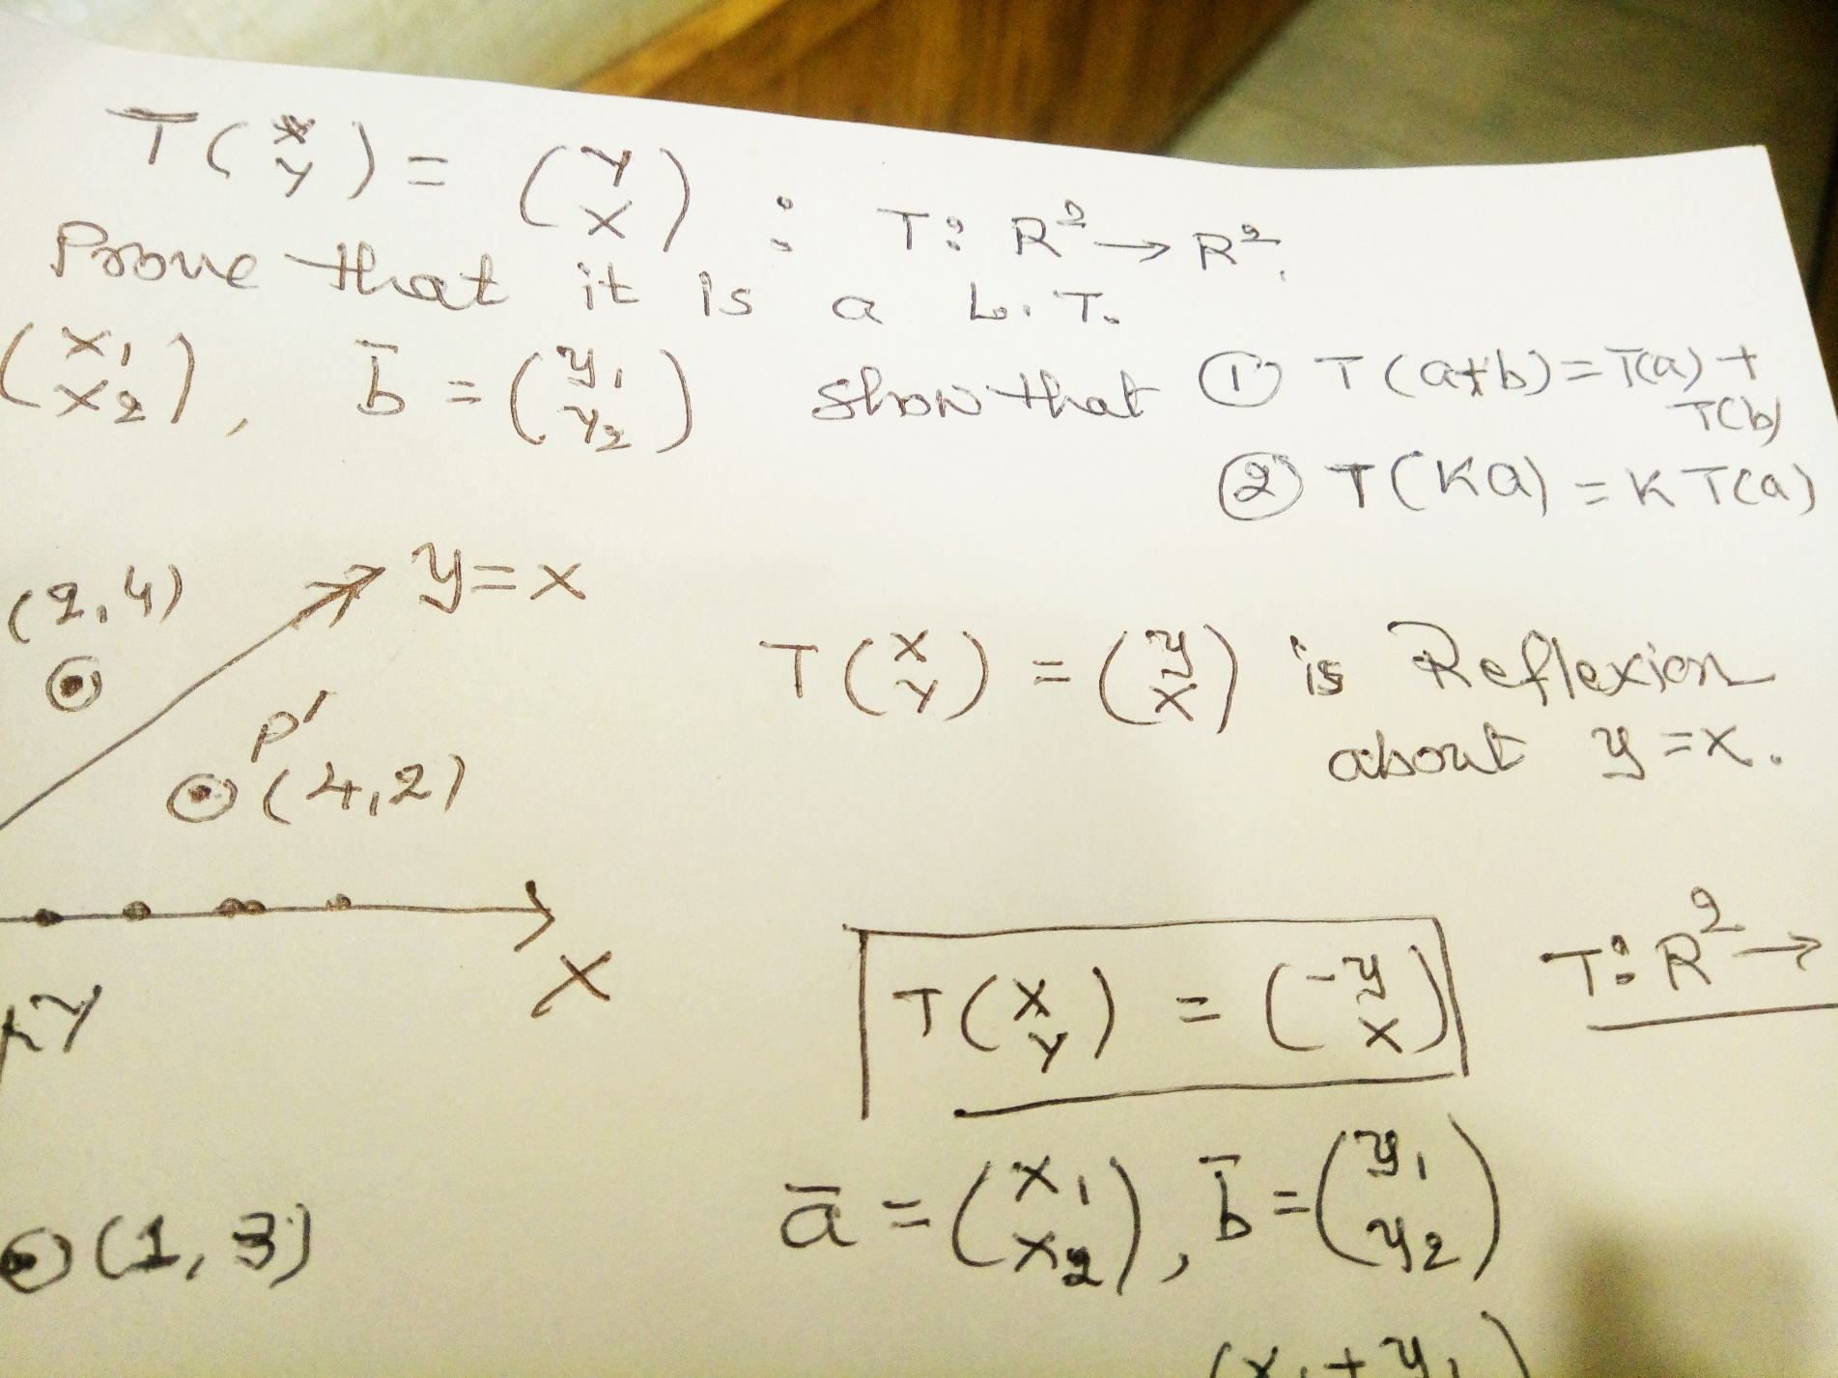
Lalp2.12

Slide 43
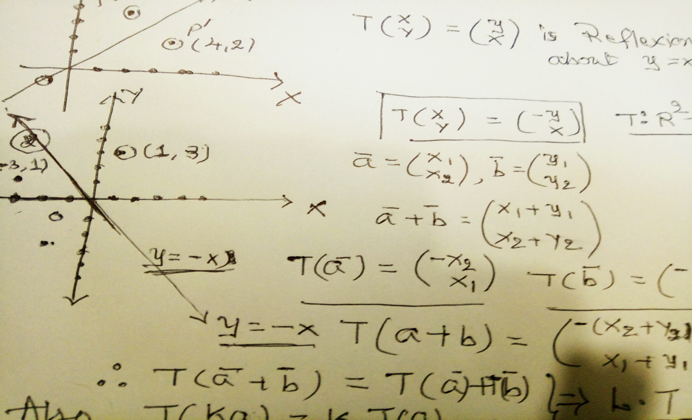
LALP 2.14

Slide 44
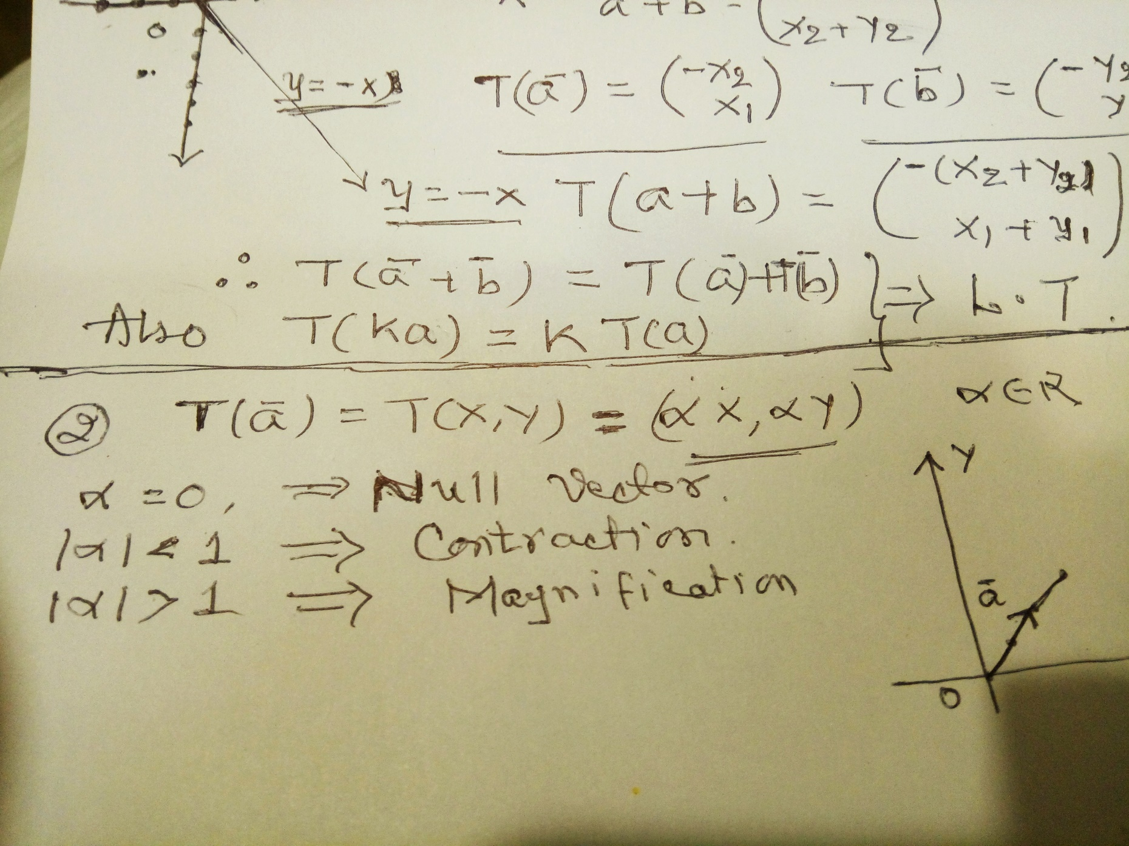
LALP13

Slide 45
LALP 2.15
of L.T
Properties
Example 1: For 0 < b< a, T(a1,a2) = (a1, (b/a)a2) is a linear transformation which converts circle x² + y² = a² ontothe ellipse (x/a)² + (y/b)² =1
2 : For a L.T. T : U V, for ϴ $∈U T(\text{ϴ}$) = ϴ
3 : For a L.T, T : U V, for any x $∈U$ , T(-x) = - T(x)
4 : For a L.T, T : U V, for any x1, x2 $∈U$, T (x1-x2) = t(x1) – T(x2)
5 For a L.T, T : U V, The set N(T) ={ x| T(x) = ϴ} is called a null space, ϴ $∈$ V
N(T) is called ‘ kernel’ of L.T
6 For a L.T. T:U V , the set R(T) = {T(x) = y , for each x $∈U$} is called the range of L.T

Slide 46
LALP 2.16
If U = {x1,x2, … xn} then R(T) = { T(x1), T (x2),…… T(xn)}
The null space N(T) is a subspace of U and the Range is a subspace of V.
Linear Transformaation on basis:
1 Standard Basis of R² = {(1,0), (0,1)} = {I ,j } = standard basis of R²
T : R² R² , so that for any (x,y) in R², T(x,y) = ( 2x+ y , x +2y)
Is T linear?, In fact, T$\left(\begin{matrix}x \\ y\end{matrix}\right)= \left(\begin{matrix}2x+y \\ x+2y\end{matrix}\right)$
What is T$\left(\begin{matrix}1 \\ 0\end{matrix}\right)= \left(\begin{matrix}2.1 +0 \\ 1+2.0 \end{matrix}\right)=\left(\begin{matrix}2 \\ 1\end{matrix}\right)$
In the same way, T$\left(\begin{matrix}0 \\ 1\end{matrix}\right)= \left(\begin{matrix}2.0 +1 \\ 0+2.1 \end{matrix}\right)=\left(\begin{matrix}1 \\ 2\end{matrix}\right)$

Slide 47
LALP 2.17
T$\left(\begin{matrix}1 \\ 0\end{matrix}\right)= \left(\begin{matrix}2 \\ 1\end{matrix}\right)$ and
T$\left(\begin{matrix}0 \\ 1\end{matrix}\right)= \left(\begin{matrix}1 \\ 2\end{matrix}\right)$
The L.T. converts vectors of standard basis B1 = { i, j} in to {T(i), T(j)}
In our case, T(i) = T$\left(\begin{matrix}1 \\ 0\end{matrix}\right)= \left(\begin{matrix}2 \\ 1\end{matrix}\right)$ , T(j) = T$\left(\begin{matrix}0 \\ 1\end{matrix}\right)= \left(\begin{matrix}1 \\ 2\end{matrix}\right)$
T ($\left(\begin{matrix}1 \\ 0\end{matrix}\right), \left(\begin{matrix}0 \\ 1\end{matrix}\right)$} = { T$\left(\begin{matrix}1 \\ 0\end{matrix}\right),$ T$\left(\begin{matrix}0 \\ 1\end{matrix}\right) \}=\{\left(\begin{matrix}2 \\ 1\end{matrix}\right)$ , $\left(\begin{matrix}1 \\ 2\end{matrix}\right)$}= $\left(\begin{matrix}2 & 1 \\ 1 & 2\end{matrix}\right)$
So the $\left(\begin{matrix}2 & 1 \\ 1 & 2\end{matrix}\right)$ is the result of L.T. on the standard basis.
The given L.T. converts/ transforms the basic vectors column vectors of domain set into

Slide 48
LALP 2.18
$\left(\begin{matrix}2 & 1 \\ 1 & 2\end{matrix}\right)$ . THIS IS CALLED A MATRIX OF L.T.
EXAMPLE 2:
Let T: R² R³ defined as , in the form of row vectors, T(a,b) = ( b, a, a+b)
Standard basis of R² are {(1,0), (0,1)}. They will be converted using this L.T.
T(a,b) = ( b, a, a+b), T (1,0) = (0,1, 1+0) = (0,1,1)
T(0,1) = (1,0, 0+1) = (1,0,1)
these are to be written in to the form of column form; $\left(\begin{matrix}0 \\ 1 \\ 1\end{matrix}\right)$ and $\left(\begin{matrix}1 \\ 0 \\ 1\end{matrix}\right)$
So we have $\left(\begin{matrix}0 \\ 1 \\ 1\end{matrix} \begin{matrix}1 \\ 0 \\ 1\end{matrix}\right)$ as result. It is a matrix of the order 3x2.

Slide 49
LALP 2.19
EXAMPLE 3:
Let T: R³ R² defined as , in the form of row vectors, T(a,b,c) = ( a+b, c+b)
Standard basis of R² are {(1,0,0), (0,1,0), (0,0,1)}. They will be converted using this L.T.
T(a,b,c) = (a+b, c+b), T (1,0, 0) = (1+0, 0+0) = (1,0)
T(0,1,0) = (0+1, 0+1) = (1,1)
T(0,0,1) = (0+0,1+0) = (0,1)
these are to be written in to the form of column form; $\left(\begin{matrix}1 \\ 0\end{matrix} \begin{matrix}1 \\ 1\end{matrix} \begin{matrix}0 \\ 1\end{matrix}\right)$
So we have as result $\left(\begin{matrix}1 \\ 0\end{matrix} \begin{matrix}1 \\ 1\end{matrix} \begin{matrix}0 \\ 1\end{matrix}\right)$ . It is a matrix of the order 2x3.

Slide 50
LALP 2.20
Matrix is a result of linear transformation on the basis of the domain set.
It is written as (T: B1, B2) where B1 and B2 are standard basis of the domain and codomain.
There may be different basis of domain and codomain also.
Assignment 1:
Ex-1 Determine the matrix associated with T(a,b) = ( a a+b)
Ex-2 Determine the matrix associated with T(a,b) = ( a a+b, a-b)
Ex-3 Determine the matrix associated with T(a,b,c) = ( 2a a+b, a-b)
Ex-4 Determine the matrix associated with T(a,b,c) = ( 2a+c, c+b)
Ex-5 Determine the matrix associated with T(a,b, c,d ) = ( a+d, b+c, d+c+a)

Slide 51
Matrix Algebra
Dr. Pradeep .J.Jha

Slide 52
LALP. 3.1
We know that a matrix is a result of Linear Transformation on basis of the first space onto the( basis) of the second space.
Ex-1 Let T : R² R³ defined as T(x,y) = ( x-y, 2x, 3y). We find [ t,b1,b2] where b1 and b2 are the standard basis of R² and R³.
We know that b1 = { (1,0), (0, 1)} and b2 = { (1, 0, 0) , (0 ,1, 0), (0, 0 ,1)}
These are the standard basis of the two spaces. As T(x,y) = ( x-y, 2x, 3y).
We have T(1,0) = ( 1-0, 2 .1, 3.0) = (1,2,0); actually to be written as $\left(\begin{matrix}1 \\ 2 \\ 0\end{matrix}\right)$
Also T(0,1) = (0-1 , 2.0 , 3.1) = (-1, 0,3) actually to be written as$\left(\begin{matrix}−1 \\ 0 \\ 3\end{matrix}\right)$

Slide 53
LALP. 3.2
So we have T(1,0) = $\left(\begin{matrix}1 \\ 2 \\ 0\end{matrix}\right) and$T(0,1) = $\left(\begin{matrix}−1 \\ 0 \\ 3\end{matrix}\right)$
The basis b1 = { (1,0), (0, 1)} by the action of L.T. is transformed in$\left(\begin{matrix}1 \\ 2 \\ 0\end{matrix} \begin{matrix}−1 \\ 0 \\ 3\end{matrix}\right)$ ; this is a matrix which has 3 rows and 2 columns. (T: R² to R³)
1 Matrix is denoted by capital letter. Say A = $\left(\begin{matrix}1 \\ 2 \\ 0\end{matrix} \begin{matrix}−1 \\ 0 \\ 3\end{matrix}\right)$
2 Matrix is an arrangement of mn numbers in the form of m rows and n columns. A = $\left(a_{ij}\right)$or$\left(a_{i,j}\right)$is the general notation. i varies from 1 to m and j varies from 1 to n.[ I for rows and j for columns]
3 It does not stand for some real value. Each entry is meaningful.

Slide 54
LALP. 3.3
4 We A = $\left(a_{ij}\right)$_{mxn} is general notation. m x n is called the order of the matrix.
2x3 shows that the matrix has 2 rows and 3 columns etc.
If m = n then it is a square matrix. If m ≠ n then is a rectangular matrix.
5 Transpose of a matrix: Let A = $\left(a_{ij}\right)$_{mxn} be a matrix.If we interchange rows in to columns then the new matrix is called transpose of the given matrix a ; it is denoted as A’ or A^{t .} A’ = (a_{ji})_{nxm} . This process changes the order of the matrix.
For A = $\left(a_{ij}\right)$_{mxn} =$\left(\begin{matrix}1 \\ 2 \\ 0\end{matrix} \begin{matrix}−1 \\ 0 \\ 3\end{matrix}\right)$ , A’ = $\left(\begin{matrix}1 \\ −1\end{matrix} \begin{matrix}2 \\ 0\end{matrix} \begin{matrix}0 \\ 3\end{matrix}\right) observe the order.$
Order of the square matrices do not change.

Slide 55
LALP 3.4
Example: Let T: R³ R^{2 ,} T(x, y, z) = (x+y –z, x-y+z) Find the corresponding matrix f linear transformation.
a = (x1,y1,z1) ,T(a) = (x1+y1-z1, x1-y1+z1)
b = (x2,y2,z2) , T(b) =(x2+y2-z2, x2-y2+z2)
To prove L.T. we prove that T(a+b) = T(a) + T(b), and T (ca) = c. T(a)
a + b = ( x1+x2, y1+y2, z1 +z2) , T(a+b) = T(x1+x2, y1+y2, z1 +z2)
= (x1+x2+y1+y2-z1-z2, x1+x2-y1-y2+z1+z2) Is it equa to T(a) + T(b) ?so T(a+b) = T(a) + T(b), check T (ca) is it same as c. T(a)?
T(cx1, cy1, cz1) apply and heck.
Both rules are satisfied and so the transformation is linear., find
T(1,0,0), T(0,1,0) and T (0,0,1)

Slide 56
LALP 3.5
Three Fundamentals: As we have three working laws in vector spaces, the same way the set of 2x2 , 3x3 (in general nxn) matrices is a vector space over the field of real numbers , set R,( the set of complex number also) with two standard operations + and x (.).
1 Equality of two matrices: Two matrices of the same order can be equated and their equality is that of corresponding elements.
E.g. Let A =$\left(\begin{matrix}a & b \\ c & d\end{matrix}\right)and B= \left(\begin{matrix}p & q \\ r & s\end{matrix}\right)$. A = B a =p, b = q, c = r, and d =s.
2 Addition of two matrices: Two matrices of the same order can be added and the resultant is also a matrix of the same order. Also their addition is of the corresponding elements.
e.g. Let A =$\left(\begin{matrix}a & b \\ c & d\end{matrix}\right)and B= \left(\begin{matrix}p & q \\ r & s\end{matrix}\right)$. Then their addition denoted as A+B

Slide 57
LALP 3.6
Is also a matrix of the same order.
A + B = C (say), and C = $\left(\begin{matrix}a+p & b+q \\ c+r & d+s\end{matrix}\right)$
3 : Multiplication of a matrix by a scalar: Let A = $\left(\begin{matrix}a & b \\ c & d\end{matrix}\right)$ and p be any number; then multiplication of the matrix by the number ‘ p’; denoted as
pA is a matrix of the order obtained by multiplying the all the elements of the matrix by the number.
For the matrix A = $\left(\begin{matrix}a & b \\ c & d\end{matrix}\right) and the number{{}_{}^{′}p}^{′};pA=\left(\begin{matrix}pa & pb \\ pc & pd\end{matrix}\right)$

Slide 58
LALP 3.7
If the scalar ‘p’ = 0, then pA = 0A = $\left(\begin{matrix}0 & 0 \\ 0 & 0\end{matrix}\right)$ is called a null matrix; denoted as 0. It can be of any order
0_{2x2} = O₂ = $\left(\begin{matrix}0 & 0 \\ 0 & 0\end{matrix}\right)$ , 0_{3x3} = O₃ = $\left(\begin{matrix}0 & 0 & 0 \\ 0 & 0 & 0 \\ 0 & 0 & 0\end{matrix}\right)$ This is also known as an additive identity. For any matrix A , A + 0 = 0 + A = A.
If the scalar ‘p’ = -1 then for any matrix A, -1A is obtained by multiplying all eements of the matrix by -1.
For A = $\left(\begin{matrix}a & b \\ c & d\end{matrix}\right)$, -1A = -A = $\left(\begin{matrix}−a & −b \\ −c & −d\end{matrix}\right)$
For the matrix A, the matrix –A is called additive inverse.
A + (-A) = (-A) + A = 0 = null matrix.

Slide 59
LALP 3.8
Illustrations:
1 Let A =$\left(\begin{matrix}2 & 5 \\ −1 & 0\end{matrix}\right)and B= \left(\begin{matrix}8 & 9 \\ 4 & −7\end{matrix}\right)$ then A + B =$\left(\begin{matrix}10 & 14 \\ 3 & −7\end{matrix}\right)$
[Note, preservation of the order and addition of corresponding members]
2 Let A =$\left(\begin{matrix}2 & 5 \\ −1 & 0\end{matrix}\right)and B= \left(\begin{matrix}8 & 9 \\ 4 & −7\end{matrix}\right)$ then find 2A + 5B
2A=2$\left(\begin{matrix}2 & 5 \\ −1 & 0\end{matrix}\right)=\left(\begin{matrix}4 & 10 \\ −2 & 0\end{matrix}\right)and 5B=5 \left(\begin{matrix}8 & 9 \\ 4 & −7\end{matrix}\right)$ = $\left(\begin{matrix}40 & 45 \\ 20 & −35\end{matrix}\right)$
Now 2A + 5B = $\left(\begin{matrix}48 & 55 \\ 18 & −35\end{matrix}\right)$
[Note, preservation of the order, multiplication by a scalar, and addition of corresponding members]

Slide 60
LALP 3.9
3 Let A = $\left(\begin{matrix}5 & −2 & 4 \\ 1 & 8 & 0 \\ 5 & 7 & 1\end{matrix}\right)$ , B = $\left(\begin{matrix}4 & 2 & 5 \\ 7 & 2 & 4 \\ 8 & 10 & 5\end{matrix}\right)$ and
2A – 3B = 2$\left(\begin{matrix}5 & −2 & 4 \\ 1 & 8 & 0 \\ 5 & 7 & 1\end{matrix}\right)$ - 3 $\left(\begin{matrix}4 & 2 & 5 \\ 7 & 2 & 4 \\ 8 & 10 & 5\end{matrix}\right)$ =
= $\left(\begin{matrix}10 & −4 & 8 \\ 2 & 16 & 0 \\ 10 & 14 & 2\end{matrix}\right)$ - $\left(\begin{matrix}12 & 6 & 15 \\ 21 & 6 & 12 \\ 24 & 30 & 15\end{matrix}\right)$ = $\left(\begin{matrix}22 & 2 & 23 \\ 23 & 24 & 12 \\ 34 & 44 & 17\end{matrix}\right)$

Slide 61
LALP 3.10
Example (Assignment part 1):
1 For the matrices A = $\left(\begin{matrix}5 & −2 & 4 \\ 1 & 8 & 0 \\ 5 & 7 & 1\end{matrix}\right)$ , B = $\left(\begin{matrix}4 & 2 & 5 \\ 7 & 2 & 4 \\ 8 & 10 & 5\end{matrix}\right)$
find 2 A’ + 3B.
2 Let A = $\left(\begin{matrix}p & 1 \\ 2p & 4\end{matrix}\right)$ , B = $\left(\begin{matrix}7 & q \\ −4 & k\end{matrix}\right)$ and 2A’ + 3B’ = 0 then find the values of P + q.
3 A = $\left(\begin{matrix}5 & 1 \\ 2 & 4\end{matrix}\right)$ , B = $\left(\begin{matrix}7 & 6 \\ −4 & 1\end{matrix}\right)$ then check whether (A + B) ‘ = A’ + B’ ?3
1 find A +B 2 find (A + B) ‘ = lhs then 3 find A’ 4 find B’ 5 find A ‘ + B’ = rhs

Slide 62
LALP 3.11
As we discussed earlier, there are two fundamental operations 1 addition of matrices and 2 Multiplication of matrices.
We have seen ‘+’ of two matrices or more matrices.
Let us study Multiplication of matrices/ Product of matrices.
Multiplication of Matrices.:
Let A = ( a_{ij}) and B = (b_{jk}) be the two matrices of the given order.
Product of two matrices denoted as AB. i changes from 1 to m, j varies from 1 to n, and k varies from 1 to p where m,n , and p are positive integers.
Product is also a matrix; say AB = C; where we write C = (c_{ik}).
C_{ik} = $\sum{c_{\begin{aligned}ik \\ \end{aligned}}}$where i = 1 to m, k = 1 to p.
c_{ik} = $\sum{a_{ij }}b_{jk}$ where the summation runs over j.

Slide 63
LALP 3.12
As j is common in both; it means that the basic condition for matrix multiplication to exist is
Number of columns of the first matrix must be equal to the number of rows of the second matrix.
A = ( a_{ij})_{mxn} and B = (b_{jk})_{nxp} , columns of A = n = rows of matrix B; this makes the product matrix AB possible. Let AB = C where each entry
C_{ik} = $\sum_{j=1}^{j=n}{a_{ij}}$ $b_{jk }$where I runs over 1 to m and j runs over 1 to n while k runs over from 1 to p.
Let A = $\left(\begin{matrix}4 & 5 & −1 \\ 0 & 2 & 3\end{matrix}\right) and B=\left(\begin{matrix}1 & 2 \\ −4 & 3\end{matrix} \right) matrix A is of order$
$2x3 wh$ile matrix B of order 2x2. Columns of A = 3 ≠ rows of B =2 and so product AB is not possible.

Slide 64
LALP 3.13
Let B= $\left(\begin{matrix}4 & 5 & −1 \\ 0 & 2 & 3\end{matrix}\right) and A=\left(\begin{matrix}1 & 2 \\ −4 & 3\end{matrix} \right) matrix$ Bis of 2x3 and A is of
order 2x2. Columns of A =3not equal to rows of B. In this case product BA is not possible. Ab is possible.
$A=\left(\begin{matrix}1 & 2 \\ −4 & 3\end{matrix} \right)$ and B= $\left(\begin{matrix}4 & 5 & −1 \\ 0 & 2 & 3\end{matrix}\right)$ As snown, the new matrix AB = C is such that each row of C will be the ‘ sum of corresponding rows of A with corresponding columns of B.’
First row of A with corresponding first column of B.= 1 . 4 + 2 .0 = 4
First row of A with corresponding Second column of B = 1 .5 + 2 .2 = 9
First row of A with corresponding third column of B = 1 . (-1) + 2 . 3= 5
Second row of A with corresponding first column of B = (-4).4 + 3 . 0 = -16
Second row of A with corresponding second column of B= (-4).5 + 3 .2= -14
Second row of A with corresponding third column of B (-4).(-1) + 3 . 3 = 13

Slide 65
LALP 3.14
With this, the product matrix AB = C =$\left(\begin{matrix}4 \\ −16\end{matrix}\begin{matrix} 9 \\ −14\end{matrix}\begin{matrix} 5 \\ 13\end{matrix}\right)$.
It is a matrix of order 2x3.= rows of A and columns of B.
Note that: It is possible that
1 Product matrices AB and BA both may not be possible.
2 Product AB be possible but BA may not be possible.
3 Product AB may not be possible but BA may be possible.
4 Product AB be possible and BA is also possible.
5 For the matrix product AB = 0
6 It is possible th A $≠$ 0 and B $≠$ 0 [In addition to three regular cases like
A = 0 and B $≠$0, etc.]

Slide 66
LALP 3.15
7 If both A and B are square matrices then both the products AB and BA are possible.
8 If both the matrices are of interchangable order [like A is 2x3 and B is3x2] then also both AB and BA are possible but they are of different order. In the above case, AB is of order 2x2 and BA of order 3x3.]
Illustrations:1 A = $\left(\begin{matrix}1 & 2 \\ −3 & −6\end{matrix}\right) and$ B=$\left(\begin{matrix}6 & −4 \\ −3 & 2\end{matrix}\right)$, both are non null yet the product AB = 0
Let A = $\left(\begin{matrix}1 & 2 \\ −3 & −6\end{matrix}\right)$ and B = $\left(\begin{matrix}2 & 5 \\ 0 & −1 \\ 1 & 2\end{matrix}\right)$, A is 2x2 and B is 3x2and so AB is not possible but BA is possible. The resultant matrix is 3x2.

Slide 67
LALP 3.16
Let B = $\left(\begin{matrix}2 & 5 \\ 0 & −1 \\ 1 & 2\end{matrix}\right)$and A = $\left(\begin{matrix}1 & 2 \\ −3 & −6\end{matrix}\right)$ . The rows of BA 3x2 matrix are
2.1 + 5 x(-3) 2.2 + 5 x(-6) First row -13 -26
0.1 + (-1) .(-3) 0.2 + (-1).(-6) Second row 3 6 So BA = $\left(\begin{matrix}−13 & −26 \\ 3 & 6 \\ −5 & −10\end{matrix}\right)$
1.1 + 2. (-3) 1.2 + 2.(-6) Third row -5 -10
Most Important point to note here is Though both product AB and BA be possible, we have, in general, AB ≠ BA.
A = $\left(\begin{matrix}1 & 2 \\ −3 & −6\end{matrix}\right)$ and B= $\left(\begin{matrix}7 & 2 \\ −1 & 3\end{matrix}\right)$ Find AB and BA.
AB = BA, only if any one is a null or identity matrix or they are commutative matrices.

Slide 68
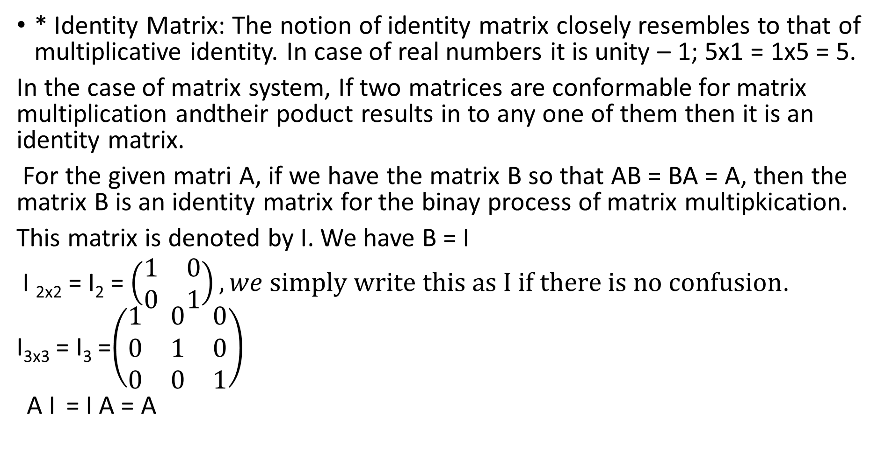
LALP 3.17
* Identity Matrix: The notion of identity matrix closely resembles to that of multiplicative identity. In case of real numbers it is unity – 1; 5x1 = 1x5 = 5.
In the case of matrix system, If two matrices are conformable for matrix multiplication andtheir poduct results in to any one of them then it is an identity matrix.
For the given matri A, if we have the matrix B so that AB = BA = A, then the matrix B is an identity matrix for the binay process of matrix multipkication.
This matrix is denoted by I. We have B = I
I _{2x2} = I₂ = $\left(\begin{matrix}1 & 0 \\ 0 & 1\end{matrix}\right), we simply write this as I if there is no confusion$.
I_{3x3} = I₃ =$\left(\begin{matrix}1 & 0 & 0 \\ 0 & 1 & 0 \\ 0 & 0 & 1\end{matrix}\right)$
A I = I A = A

Slide 69
LALP 3.18
Determinant of a square matrix: We know that a matrix is an arrangement or it is a presentation of common values of two different variables.
students
a b
Marks Now, one can meaningfully read each entry. There can be
different values to rows and columns.
Test 1 5 9
Test 2 6 4 If write these entries in the form of a determinant then
We have the notion of determinant. A determinant stands for a real value in the case of different order. [ Only square form]
It shows a real value and it has meaningful different value.

Slide 70
LALP 3.19
D1 = $\left\lfloor \begin{matrix}2 & 1 \\ −3 & 8\end{matrix}\right\rfloor , D2= \left\lfloor \begin{matrix}4 & 8 & 1 \\ 0 & 5 & 12 \\ 1 & 2 & 3\end{matrix}\right\rfloor$ , D1 = (2).(8) – (1)(-3) = 19
In the same way D2 = 4. $\left\lfloor \begin{matrix}5 & 12 \\ 2 & 3\end{matrix}\right\rfloor$+ (-8) $\left\lfloor \begin{matrix}0 & 12 \\ 1 & 3\end{matrix}\right\rfloor$+ (1) $\left\lfloor \begin{matrix}0 & 5 \\ 1 & 2\end{matrix}\right\rfloor$
= 4. -9 + (-8) (-12) + 1 (-5) = 55
There are some properties associated with determinants. These properties are useful in finding the value of a determinant, We will mention some on the proper time.

Slide 71
LALP 3.20
Inverse of a given matrix: As set of all square matrices on the given field of real numbers generate a vectors space with two binary operations + and ‘ . ‘, we must have a multiplicative inverse to each non-singular matrix.
For a given matrix A if we another matrix B so thar the product
AB =BA = I = identity matrix, then the matrix B is called the inverse of the given matrix A; it denoted = A⁻¹
In fact A and B are inverses of each other. A = B⁻¹ and B = A⁻¹
i.e A A⁻¹ = A⁻¹ A = I identity matix.
We have given conditions ; A must be a square matrix and it must be non-singular. A given non-singular matrix can possess inverse.

Slide 72
LALP 3.21
Non-Singular Matrix: A matrix A is non singular if its determinant value is non zero.
A =$\left(\begin{matrix}2 & 4 \\ −1 & 6\end{matrix}\right) is a square matrix then its determinant denoted$as |A| is $\left\lfloor \begin{matrix}2 & 4 \\ −1 & 6\end{matrix}\right\rfloor$ = 12 – (4) (-1) = 16 ≠ 0 and so the given matrix A is a non singular matrix.
Matrx B =$\left(\begin{matrix}4 & 8 & −2 \\ 0 & 1 & 5 \\ 1 & 2 & 2\end{matrix}\right), its determinant =\left|B\right|= \left\lfloor \begin{matrix}4 & 8 & −2 \\ 0 & 1 & 5 \\ 1 & 2 & 2\end{matrix}\right\rfloor$=
4(1.2 – 5.2) – 8(0.2 -5.1) +(-2) (0.2 – 1.1) = -32 + 40 +2 =8 ≠ 0 and so B is a non-singular matrix.
Only non-singular square matices possess inverses.

Slide 73
LALP 3.22
Inverse of the given matrix A = A⁻¹ = adj A / |A|; where adj A is called adjoint of the matrix A. It is obvious that |A| ≠ 0.
adj A is found by transposing the matrix of cofactors of all the elements of the given matrix A. Cofactor of the given matrix is obtained by attaching proper signs to the minor of each element.
Signs are =$\left(\begin{matrix}+ & − & + \\ − & + & − \\ + & − & +\end{matrix}\right)$ Note the pattern. Minors ae determinants obtained by not considering the row and the column of the given entry. We find the adjiont of the non-singular matrix that we considered.

Slide 74
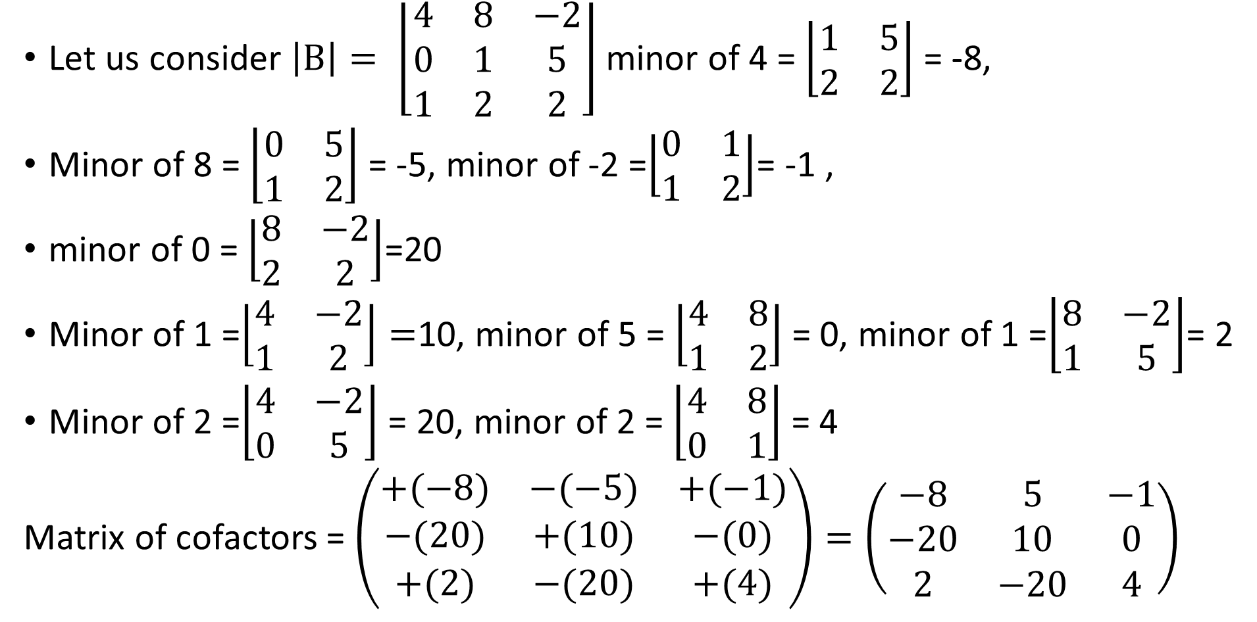
LALP 3.23
Let us consider $\left|B\right|= \left\lfloor \begin{matrix}4 & 8 & −2 \\ 0 & 1 & 5 \\ 1 & 2 & 2\end{matrix}\right\rfloor$ minor of 4 = $\left\lfloor \begin{matrix}1 & 5 \\ 2 & 2\end{matrix}\right\rfloor$ = -8,
Minor of 8 = $\left\lfloor \begin{matrix}0 & 5 \\ 1 & 2\end{matrix}\right\rfloor$ = -5, minor of -2 =$\left\lfloor \begin{matrix}0 & 1 \\ 1 & 2\end{matrix}\right\rfloor$= -1 ,
minor of 0 = $\left\lfloor \begin{matrix}8 & −2 \\ 2 & 2\end{matrix}\right\rfloor$=20
Minor of 1 =$\left\lfloor \begin{matrix}4 & −2 \\ 1 & 2\end{matrix}\right\rfloor =$10, minor of 5 = $\left\lfloor \begin{matrix}4 & 8 \\ 1 & 2\end{matrix}\right\rfloor$ = 0, minor of 1 =$\left\lfloor \begin{matrix}8 & −2 \\ 1 & 5\end{matrix}\right\rfloor$= 2
Minor of 2 =$\left\lfloor \begin{matrix}4 & −2 \\ 0 & 5\end{matrix}\right\rfloor$ = 20, minor of 2 = $\left\lfloor \begin{matrix}4 & 8 \\ 0 & 1\end{matrix}\right\rfloor$ = 4
Matrix of cofactors = $\left(\begin{matrix}+(−8) & −(−5) & +(−1) \\ −(20) & +(10) & −(0) \\ +(2) & −(20) & +(4)\end{matrix}\right)=\left(\begin{matrix}−8 & 5 & −1 \\ −20 & 10 & 0 \\ 2 & −20 & 4\end{matrix}\right)$

Slide 75
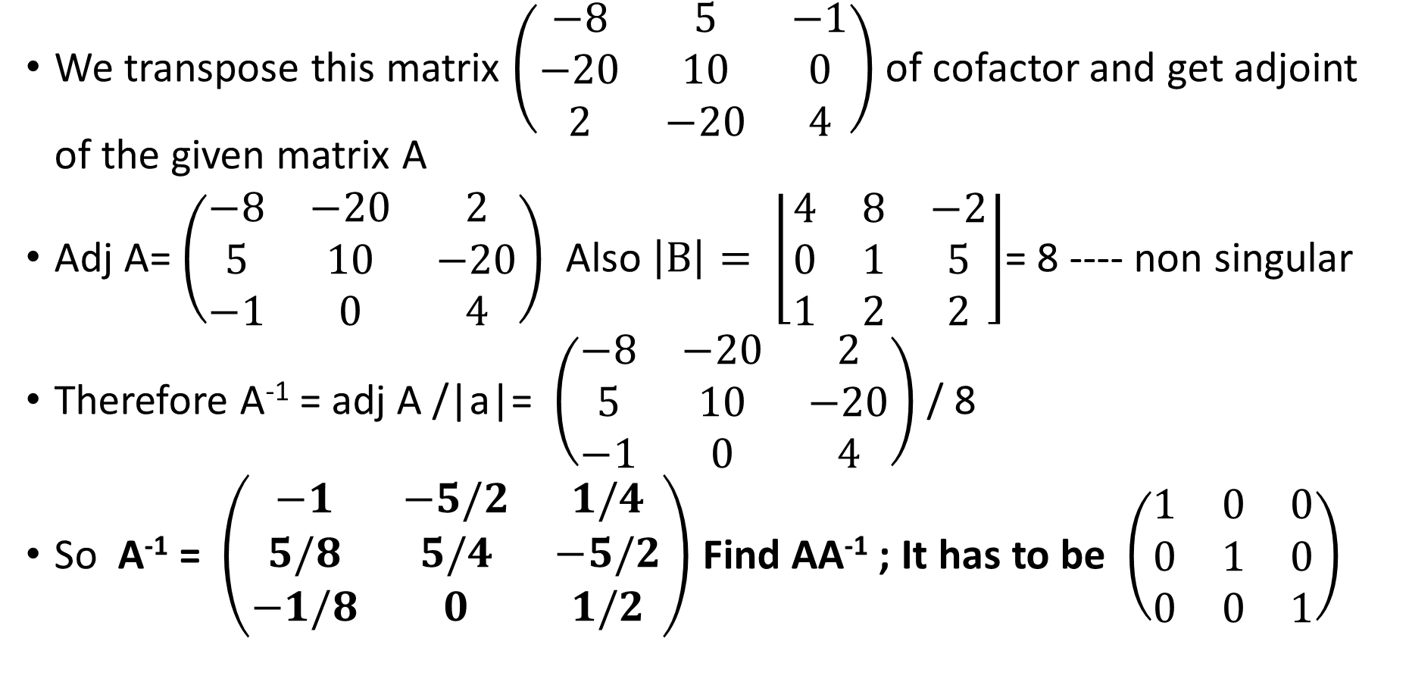
LALP 3.24
We transpose this matrix $\left(\begin{matrix}−8 & 5 & −1 \\ −20 & 10 & 0 \\ 2 & −20 & 4\end{matrix}\right)$ of cofactor and get adjoint of the given matrix A
Adj A= $\left(\begin{matrix}−8 & −20 & 2 \\ 5 & 10 & −20 \\ −1 & 0 & 4\end{matrix}\right)$ Also $\left|B\right|= \left\lfloor \begin{matrix}4 & 8 & −2 \\ 0 & 1 & 5 \\ 1 & 2 & 2\end{matrix}\right\rfloor$= 8 ---- non singular
Therefore A⁻¹ = adj A /|a|= $\left(\begin{matrix}−8 & −20 & 2 \\ 5 & 10 & −20 \\ −1 & 0 & 4\end{matrix}\right)$ / 8
So A⁻¹ = $\left(\begin{matrix}−1 & −5/2 & 1/4 \\ 5/8 & 5/4 & −5/2 \\ −1/8 & 0 & 1/2\end{matrix}\right)$ Find AA⁻¹ ; It has to be $\left(\begin{matrix}1 & 0 & 0 \\ 0 & 1 & 0 \\ 0 & 0 & 1\end{matrix}\right)$

Slide 76
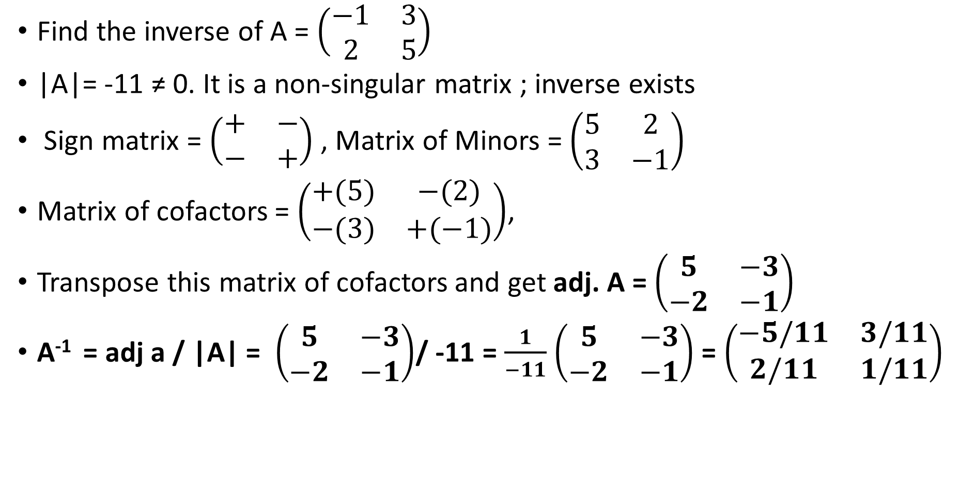
LALP 3.25
Find the inverse of A = $\left(\begin{matrix}−1 & 3 \\ 2 & 5\end{matrix}\right)$
|A|= -11 ≠ 0. It is a non-singular matrix ; inverse exists
Sign matrix = $\left(\begin{matrix}+ & − \\ − & +\end{matrix}\right)$ , Matrix of Minors = $\left(\begin{matrix}5 & 2 \\ 3 & −1\end{matrix}\right)$
Matrix of cofactors = $\left(\begin{matrix}+(5) & −(2) \\ −(3) & +(−1)\end{matrix}\right)$,
Transpose this matrix of cofactors and get adj. A = $\left(\begin{matrix}5 & −3 \\ −2 & −1\end{matrix}\right)$
A⁻¹ = adj a / |A| = $\left(\begin{matrix}5 & −3 \\ −2 & −1\end{matrix}\right)$/ -11 = $\frac{1}{−11}$ $\left(\begin{matrix}5 & −3 \\ −2 & −1\end{matrix}\right)$ = $\left(\begin{matrix}−5/11 & 3/11 \\ 2/11 & 1/11\end{matrix}\right)$

Slide 77
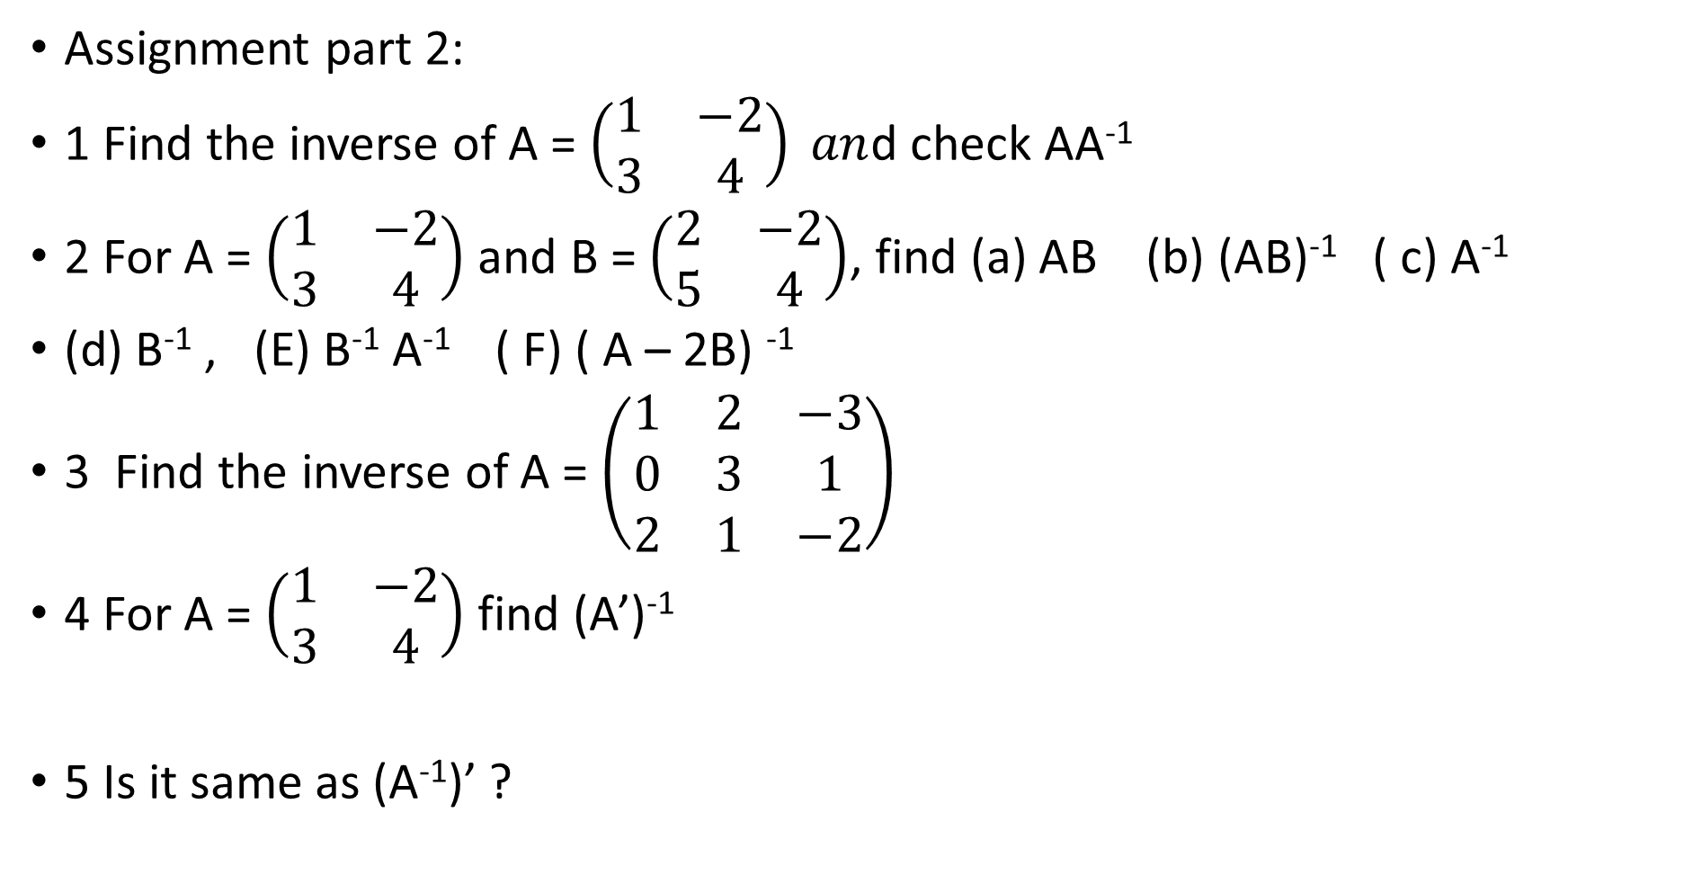
LALP 3.26
Assignment part 2:
1 Find the inverse of A = $\left(\begin{matrix}1 & −2 \\ 3 & 4\end{matrix}\right) an$d check AA⁻¹
2 For A = $\left(\begin{matrix}1 & −2 \\ 3 & 4\end{matrix}\right)$ and B = $\left(\begin{matrix}2 & −2 \\ 5 & 4\end{matrix}\right)$, find (a) AB (b) (AB)⁻¹ ( c) A⁻¹
(d) B⁻¹ , (E) B⁻¹ A⁻¹ ( F) ( A – 2B) ⁻¹
3 Find the inverse of A = $\left(\begin{matrix}1 & 2 & −3 \\ 0 & 3 & 1 \\ 2 & 1 & −2\end{matrix}\right)$
4 For A = $\left(\begin{matrix}1 & −2 \\ 3 & 4\end{matrix}\right)$ find (A’)⁻¹
5 Is it same as (A⁻¹)’ ?

Slide 78
LALP unit 4
DR. Pradeep . J. .Jha

Slide 79
LALP 4.1
System of linear Equations:
We have a system of two linear equations in R² which shows two lines. Either they are parallel or they intersect at one point only. This is the point of intersection of two lines. It means that the coordinate of that point will satify equation of both lines.
We would like to identify such situations using the notion of ‘ inverse of a matrix’.
We consider two examples in order to verify existence of point of intersection.
General approach:
Consider a1x + b1y = c1 …(1)
and a2x + b2y = c2 . .. (2)

Slide 80
LALP 4.2
The system in matrix equation form can be written as
$\left(\begin{matrix}a1 & b1 \\ a2 & b2\end{matrix}\right) \left(\begin{matrix}x \\ y\end{matrix}\right)= \left(\begin{matrix}c1 \\ c2\end{matrix}\right)$ check this; say AX = B
A X B
If the solution of the system; i.e. values of x, and y which can satisfy the equation.
So X = $\left(\begin{matrix}x \\ y\end{matrix}\right)$ = A⁻¹ B where A⁻¹ = adj A/ |A| if |A| ≠0, I,e. A is a non- singular matrix.
Example 1: Solve the system x +2y =5, 3x + 4y = 11,
In the matrix notation the system is $\left(\begin{matrix}1 & 2 \\ 3 & 4\end{matrix}\right)\left(\begin{matrix}x \\ y\end{matrix}\right)=\left(\begin{matrix}5 \\ 11\end{matrix}\right)$
A X = B

Slide 81
LALP 4.3
A =$\left(\begin{matrix}1 & 2 \\ 3 & 4\end{matrix}\right), X=\left(\begin{matrix}x \\ y\end{matrix}\right) ,B=\left(\begin{matrix}5 \\ 11\end{matrix}\right)$, |A| = 4 -6 = -2 ≠ 0 , A is non –singular matrix. Therefore A⁻¹ exists. So the system AX = B has a solution
$∴$ X = A⁻¹B, ….(1)
Matrix of cofactors = $\left(\begin{matrix}+(4) & −(3) \\ −(2) & + (1)\end{matrix}\right)$ Transpose this; adj A = $\left(\begin{matrix}4 & −2 \\ −3 & 1\end{matrix}\right)$
Using (1) X = $\left(\begin{matrix}x \\ y\end{matrix}\right)$ = $\frac{1}{−2}$ $\left(\begin{matrix}4 & −2 \\ −3 & 1\end{matrix}\right)$ $\left(\begin{matrix}5 \\ 11\end{matrix}\right)$ = $\left(\begin{matrix} −2 5 +\left(1\right)(11) \\ \left(\frac{3}{2}\right). 5−\left(\frac{1}{2}\right). 11\end{matrix}\right)$ =$\left(\begin{matrix}1 \\ 2\end{matrix}\right)$
$∴$ x =1 and y = 2 = (1/-2) $\left(\begin{matrix}−2 \\ −4\end{matrix}\right)$ = $\left(\begin{matrix}1 \\ 2\end{matrix}\right)$ =$\left(\begin{matrix}x \\ y\end{matrix}\right)$

Slide 82
LALP 4.4
Row operations : There are three types of row operations on the rows of given matrix.
1 Interchange of any two rows. R1 R2
2 Multiplying i th row by a constant k and adding the result to the corresponding members of j th row. R_{ij} (k)
3 Multiplying all the members of a row by a constant c. Denoted as cR
Let A = $\left(\begin{matrix}1 & 2 & −3 \\ 0 & 12 & 2 \\ 6 & 7 & 5\end{matrix}\right)$ perform r2 to r3, $∴$ A’ = $\left(\begin{matrix}1 & 2 & −3 \\ 6 & 7 & 5 \\ 0 & 12 & 2\end{matrix}\right)$
Multiply r1 by -6 and add to corresponding members of the second row r2.
A’’ = $\left(\begin{matrix}1 & 2 & −3 \\ −6 & 0 & 20 \\ 6 & 7 & 5\end{matrix}\right)$ Multiply r3 by ½ . A’’’ = $\left(\begin{matrix}1 & 2 & −3 \\ −6 & 0 & 20 \\ 3 & 7/2 & 5/2\end{matrix}\right)$

Slide 83
LALP 4.5
x +2y =5, 3x + 4y = 11, The system is A =$\left(\begin{matrix}1 & 2 \\ 3 & 4\end{matrix}\right) ,B=\left(\begin{matrix}5 \\ 11\end{matrix}\right)$ The system is
$\left(\begin{matrix}1 & 2 \\ 3 & 4\end{matrix} \begin{matrix}1 & 0 \\ 0 & 1\end{matrix}\right)\left(\begin{matrix}5 \\ 11\end{matrix}\right)$ The central idea is to apply row operations on the given matrix A so that it is converted in to identity matrix and hence the augmented matrix (identity matrix) becomes inverse of the given matrix and the resource matrx will become the solution of the system.
Multiply the first row by 3 and subtract the corresponding members from second row. $\left(\begin{matrix}1 & 2 \\ 0 & −2\end{matrix} \begin{matrix}1 & 0 \\ −3 & 1\end{matrix}\right)\left(\begin{matrix}5 \\ −4\end{matrix}\right)$ R₁₂ (-3) , Add second row to first row.
$\left(\begin{matrix}1 & 0 \\ 0 & −2 \end{matrix} \begin{matrix}−2 & 1 \\ −3 & 1\end{matrix}\right)\left(\begin{matrix}1 \\ −4\end{matrix}\right)$ , Divde second row by -2,
$\left(\begin{matrix}1 & 0 \\ 0 & 1 \end{matrix} \begin{matrix}−2 & 1 \\ 3/2 & −1/2\end{matrix}\right)\left(\begin{matrix}1 \\ 2\end{matrix}\right)$ So x = 1 and y =2, inverse of A= A⁻¹= $\left(\begin{matrix}−2 & 1 \\ 3/2 & −1/2\end{matrix}\right)$

Slide 84
LALP 4.6
Ex-2 Solve the system of equations.
2x – 3y = 2 Which in the matrix form $\left(\begin{matrix}2 & −3 \\ 1 & 2\end{matrix}\right)\left(\begin{matrix}x \\ y\end{matrix}\right)=\left(\begin{matrix}2 \\ −6\end{matrix}\right)$
1x + 2y = -6 A X = B (1) Solution is
X = A⁻¹ B
1 |A| = 7≠ 0 $∴$ |A| is a non-zero ( non- singularmatrix. $∴$ Imverse exists.
Matrix of cofactors = $\left(\begin{matrix}+(2) & −(1) \\ −(−3) & +(2)\end{matrix}\right)$ = $\left(\begin{matrix}2 & −1 \\ 3 & 2\end{matrix}\right)$. Transpose it.
$∴$ Adj . A = $\left(\begin{matrix}2 & 3 \\ −1 & 2\end{matrix} \right)$. From (1) X = $\left(\begin{matrix}x \\ y\end{matrix}\right)$ = A ⁻¹ B= ((adj A)/ |a| ) B
X = $\left(\begin{matrix}x \\ y\end{matrix}\right)$ = (1/7) $\left(\begin{matrix}2 & 3 \\ −1 & 2\end{matrix} \right)\left(\begin{matrix}2 \\ −6\end{matrix}\right)$ = (1/7)$\left(\begin{matrix}−14 \\ −14\end{matrix}\right)$= $\left(\begin{matrix}−2 \\ −2\end{matrix}\right)$ = $\left(\begin{matrix}x \\ y\end{matrix}\right)$
Now find the solution.

Slide 85
LALP 4.7
$\left(\begin{matrix}2 & −3 \\ 1 & 2\end{matrix} \begin{matrix}1 & 0 \\ 0 & 1\end{matrix}\right)\left(\begin{matrix}2 \\ −6\end{matrix}\right)$ , Apply row operations to convert A in to identity.
Divide first row by 2 and subtract it from second row. $\left(\begin{matrix}2 & −3 \\ 0 & 7/2\end{matrix} \begin{matrix}1 & 0 \\ −1/2 & 1\end{matrix}\right)\left(\begin{matrix}2 \\ −7\end{matrix}\right)$
Multiply the second row by 6/7 and add to the first row.
$\left(\begin{matrix}2 & 0 \\ 0 & 7/2\end{matrix} \begin{matrix}−3/7 & 6/7 \\ −1/2 & 1\end{matrix}\right)\left(\begin{matrix}−4 \\ −7\end{matrix}\right)$
Make the first matrix an identity mtrix.
Divide the first row by 2 and multiply the second row by 2/7.
$\left(\begin{matrix}1 & 0 \\ 0 & 1\end{matrix} \begin{matrix}−3/14 & 3/7 \\ −1/7 & 1/7\end{matrix}\right)\left(\begin{matrix}−2 \\ −2\end{matrix}\right)$. $∴$ x = -2, and y = -2, A⁻¹ = $\left(\begin{matrix}−3/14 & \frac{3}{7} \\ −1/7 & 1/7\end{matrix}\right)$

Slide 86
LALP 4.8
Solve the system :
x + y + z = 0 In the matrix notation, $\left(\begin{matrix}1 & 1 & 1 \\ 2 & −1 & 1 \\ 0 & 1 & 2\end{matrix}\right)\left(\begin{matrix}x \\ y \\ z\end{matrix}\right)=\left(\begin{matrix}0 \\ 1 \\ 0\end{matrix}\right)$
2x –y +z =1
y +2z =0 We write it as $\left(\begin{matrix}1 & 1 & 1 \\ 2 & −1 & 1 \\ 0 & 1 & 2\end{matrix} \begin{matrix}1 \\ 0 \\ 0\end{matrix} \begin{matrix}0 \\ 1 \\ 0\end{matrix} \begin{matrix}0 \\ 0 \\ 1\end{matrix} \right)\left(\begin{matrix}0 \\ 1 \\ 0\end{matrix}\right)$
Multiply r1 by 2 and subtract from r2, $\left(\begin{matrix}1 & 1 & 1 \\ 0 & −3 & −1 \\ 0 & 1 & 2\end{matrix} \begin{matrix}1 \\ −2 \\ 0\end{matrix} \begin{matrix}0 \\ 1 \\ 0\end{matrix} \begin{matrix}0 \\ 0 \\ 1\end{matrix} \right)\left(\begin{matrix}0 \\ 1 \\ 0\end{matrix}\right)$
Subtract r3 from r1, $\left(\begin{matrix}1 & 0 & −1 \\ 0 & −3 & −1 \\ 0 & 1 & 2\end{matrix} \begin{matrix}1 \\ −2 \\ 0\end{matrix} \begin{matrix}0 \\ 1 \\ 0\end{matrix} \begin{matrix}−1 \\ 0 \\ 1\end{matrix} \right)\left(\begin{matrix}0 \\ 1 \\ 0\end{matrix}\right)$

Slide 87
LALP 4.9
Solve by matrix inversion and also by Gauss Jordan method.
Ex 1 Solve 2x + 3y = 14 and 4x + y = 8 $\left(\begin{matrix}2 & 3 \\ 4 & 1\end{matrix} \begin{matrix}1 \\ 0\end{matrix} \begin{matrix}0 \\ 1\end{matrix} \right)$ $\left(\begin{matrix}14 \\ 8\end{matrix}\right)$ r1- (3/2) r2
Ex-2 Solve 4x -3y = 11, and 2x + y = 3 $\left(\begin{matrix}4 & −3 \\ 2 & 1\end{matrix} \begin{matrix}1 \\ 0\end{matrix} \begin{matrix}0 \\ 1\end{matrix} \right)$ $\left(\begin{matrix}11 \\ 3\end{matrix}\right)$
Ex-3 x + 2y –z = 6, 2x + y + z = 3, 3x –y +z =3
Ex – 4 2x + y + z =3, 4x + 3y +z = 9, x + 2y + 2z = 3
$\left(\begin{matrix}2 & 1 & 1 \\ 4 & 3 & 1 \\ 1 & 2 & 2\end{matrix} \begin{matrix}1 & 0 & 0 \\ 0 & 1 & 0 \\ 0 & 0 & 1\end{matrix} \right)\left(\begin{matrix}3 \\ 9 \\ 3\end{matrix}\right)$ ½ r1, r2 -4r1, r3- r1, ………, r3. (1/4),
r3 (3) +r2, r1- (1/2) r2, r1- (1/2) r3

Slide 88
LALP SET 5
Dr. Pradeep .J.Jha

Slide 89
LALP 5.1
Linear Programming: (L.P.)
When the resources like money, manpower, material, and time are to be allocated to different types of activities on certain given constraints wth an objective like maximizing the profit or minimizing the loss, we have problems
. Activities consume resources which are given to perform activities like production, sale, marketing, and parallel work like these but all these have an objective. Objectives may be like profit / production maximization or may be of cost minimization.
Conditions imposed on execution of activities on consumption of resources are called constraints.
In this way, the number of units of the activities of each type will be called Decision variable.

Slide 90
LALP 5.2
In most of the cases the decision variables are required to be non-negative.
All the decision variables, wherever they appear ( in objective function or in the constraints) are always linear.
Programming does not mean computer programming but it means ‘planning ‘. Planning of allocation of resources in to the different activities with specific objective.

Slide 91
LALP 5.3
A designer plans to share two departments A and B available for 160 and 180 hours respectively. He thinks of manufacturing tables and chairs which will be sold in the market with a profit of 10 rs. and 15 rs. Respectively. One table takes 4 hours in dept. A and the chair takes 2 hours in dept. B. A chair takes 3 hours in dept. A and 6 hours in dept. B. Deprtment A and B are available for 160 and 180 hours respectively. Design allocations so tht he gets maximum profit.
Resources: Dept A: 160 hours and dept. B : 180 hours.
Activities : Tables Chairs
Dept A Dept. B profit per unit
Table: 4 2 rs. 10
Chair 2 6 rs. 15

Slide 92
LALP 5.4
Resources: Dept A: 160 hours and dept. B : 180 hours.
Activities : Tables Chairs
Dept A Dept. B profit per unit Plan
Table: 4 2 rs. 10 x units
Chair 2 6 rs. 15 y units
Find x and y so that F(x,y) = 10 x + 15 y is maximized
With constraint on resources (1) 4x + 2y ≤ 160 , (2) 2x + 6y ≤ 180
Non negativity constraints (2) x , y ≥ 0

Slide 93
LALP 5.5
General (LPP)Model:
Find x₁ , x2,……,xn ( Decision variables)
In order to optimize z = c1x1 + c2x2 + c3x3 + …………………+ cnxn (1)
Subject to a11 x1 + a12 x2 + ………………………..+ a1n xn ≤, =, ≥ b1
a21 x1 + a22 x2 + ………………………..+ a2n xn ≤ ,= , ≥ b2
am1 x1 + am2 x2 + ………………………..+ amn xn ≤ = ≥ b_{m}
( Where in each each constraint one and only one sign holds true)
With all xi ≥ 0 [ There are n D.V. and m constraints, m ≤ n]
All ci ≥ 0 are cost / profit factors. All bi ≥ 0 are the resources
A = (a_{ij}) is a mxn matrix.

Slide 94
LALP 5.6
Ex. 2 Planning a menu. Type P and Type Q.
fat Carbohydrate Protein ( content in 10 gram) cost/10gram
Type P. 2 3 5 10
Type Q 3 4 2 20
Requirement 20 24 16
(minimum)
Let x1 and x2 be amount of type p and type q of the food to be planned to satisfy the requirement and minimize the cost.
Construct the model. Find x1 and x2 so as to minimize the total purchase cost: 10 x1 + 20 x2 subject to 2x1 + 3x2 ≥ 20 fat const.
3x1 + 4x2 ≥ 24, 5x1 + 2x2 ≥ 16,
With x1, x2 ≥ 0

Slide 95
LALP 5.7
Ex-3 investment of 200,000 in two types of bonds aa and bb.
aa pays 7% and bb pays 9 % interest. Not more than 60.000 to be invested in bb. The amount invested in aa must be at least twice of the one invested in bb. Find the solution .
Say x rs. In aa type and y rs. In bb type.
To maximize : 0.07 x + 0.09 y interest from both aa and bb
x + y = 200000
y ≤ 60000
x ≥ 2y
with x, y ≥ 0

Slide 96
LALP 5.5
General (LPP)Model:
Find x₁ , x2,……,xn ( Decision variables)
In order to optimize z = c1x1 + c2x2 + c3x3 + …………………+ cnxn (1)
Subject to a11 x1 + a12 x2 + ………………………..+ a1n xn ≤, =, ≥ b1
a21 x1 + a22 x2 + ………………………..+ a2n xn ≤ ,= , ≥ b2
am1 x1 + am2 x2 + ………………………..+ amn xn ≤ = ≥ b_{m}
( Where in each each constraint one and only one sign holds true)
With all xi ≥ 0 [ There are n D.V. and m constraints, m ≤ n]
All ci ≥ 0 are cost / profit factors. All bi ≥ 0 are the resources
A = (a_{ij}) is a mxn matrix.

Slide 97
LALP 5.8
General form of the model, Matrix form:
Now we write the matrix form of the model: Find the matrix X so as to
Optimize Z = C’X (1) [ standard form has max. with all ≤ or = type,
and mini. With all ≥ or = type]
Subject to AX ≤ = ≥ b (2)
With X ≥ 0 (3) where C’= ${\left(\begin{matrix}c_{1} & c_{2} \begin{matrix}.. & ..\end{matrix} & c_{n}\end{matrix}\right)}_{1xn}$ X = ${\left(\begin{matrix}x_{1} \\ \begin{aligned}x_{2} \\ …. \\ …\end{aligned} \\ x_{n}\end{matrix}\right)}_{nx1}$
b = ${\left(\begin{matrix}b_{1} \\ \begin{aligned}b_{2} \\ …. \\ …\end{aligned} \\ b_{m}\end{matrix}\right)}_{mx1}$, and A = $\left(\begin{aligned}\begin{matrix}a_{11} & a_{12}……………. & a_{1n}\end{matrix} \\ \begin{matrix}a_{21} & a_{22…..………………….} & a_{2n}\end{matrix} \\ \begin{matrix}a_{31} & a_{32…………………….} & a_{3n} \\ …. & ….. & …….\end{matrix} \\ \begin{matrix}a_{m1} & a_{m2……………………} & a_{mn}\end{matrix}\end{aligned}\right)$

Slide 98
LALP 5.9
E.g. Find x and y so as to maximize z = 4x + 6y subject to
2x + 4y ≤ 7
3x + 7y ≤ 12 with x , y ≥ 0
Find x =$\left(\begin{matrix}x \\ y\end{matrix}\right)$, C‘= $\left(\begin{matrix}4 & 6\end{matrix}\right)$, A = $\left(\begin{matrix}2 & 4 \\ 3 & 7\end{matrix}\right)$ , b = $\left(\begin{matrix}7 \\ 12\end{matrix}\right)$
Maximize z = C’X , subject to AX ≤ b with X =$\left(\begin{matrix}x \\ y\end{matrix}\right)$ ≥ $\left(\begin{matrix}0 \\ 0\end{matrix}\right)$
Find X =$\left(\begin{matrix}x \\ y\end{matrix}\right)$ so as to maximize Z = $\left(\begin{matrix}4 & 6\end{matrix}\right)$ $\left(\begin{matrix}x \\ y\end{matrix}\right)$
Subject to $\left(\begin{matrix}2 & 4 \\ 3 & 7\end{matrix}\right)\left(\begin{matrix}x \\ y\end{matrix}\right)$ ≤ $\left(\begin{matrix}7 \\ 12\end{matrix}\right)$ with $\left(\begin{matrix}x \\ y\end{matrix}\right)$ ≥ $\left(\begin{matrix}0 \\ 0\end{matrix}\right)$

Slide 99
LALP 5.10
A step towards solution:
When there are exactly two variables we can find the graphical soluton of the problem.
Find X to Maximize z = C’X (1)
subject to AX ≤ b (2)
with X =$\left(\begin{matrix}x \\ y\end{matrix}\right)$ ≥ $\left(\begin{matrix}0 \\ 0\end{matrix}\right)$ (3)
Any set of values of x and y which satisfy (1) and (2) is called a solution.
If the same satisfies all (1), (2), and (3) is called a feasible solution of the system.

Slide 100
LALP 5.11
Graphical Solution:
1 When there are exactly two variables one can use graphical solution.
2 Consider inequality of the constraint as equality. Each equality is now an equation of a line. Ax + by + c = 0
3 Considering the last non-negativity constraint we shall find our feasible solution in first quadrant only.
4 Draw each constraint line and find region corresponding to inequality.
5 Do the same for all constraints.
6 Find the most common region to all inequality constraints.
7 If the common region is a convex polygon or an open region bounded below then only the optimal solution exists.

Slide 101
LALP 5.13
8 The optimal solution exists on at least one ( may be more) of the vertices.
9 Find all the vertices and evaluate the objective function and make selection of optimal value.
-------------------------------------------------------------------------------
Some points:
X = 0 is an equation of y axis. Y = 0 is an equation of x axis.
From one point there passes infinite number of lines but from any two points there passes exactly one unique line.
Two non parallel lines intersect at one point only.
Equation of a line passing through two points (x1, y1) and (x2, y2) is
$\left(\frac{x −x1}{x1−x2}\right)$ = $\left(\frac{y −y1}{y1−y2}\right)$ or $\left\lfloor \begin{matrix}x & y & 1 \\ x1 & y1 & 1 \\ x2 & y2 & 1\end{matrix}\right\rfloor$ = 0

Slide 102
LALP 5.14
Two intercept Form: y x =2
X = constant is a line parallel to y axis. Y = 1
Y = constant is a line parallel to x axis. 0 x
If ‘a’ and ‘b’ are the intercepts on x and y axis then intercept form of the line
x/a + y/b = 1 where a and b are intercepts other than zero. 2x + 4y = 8
, x/4 + y/2 =1
General equation of a line is ax + by +c = 0
Find the equation of line passing through (1 , 3) and ( -2, 4),
(x- 1)/ (1- (-2)) = (y-(3)/ ( 3- 4)
Find the intercepts of 4x + 3y = 8 4x/ 8 + 3y /8 = 1, x/2 + y/ (8/3) = 1

Slide 103
LALP 5.15
Y Find x and y so as to maximize z = 5x +7y
subject to x + y ≤ 4 (1), 3x + 8y ≤ 24 (2) with x, y ≥ 0
Solution: Consider x +y = 4 (1) for y = 0, x = 4 Point (4,0)
B(0,4) Region for x = 0, y = 4 Point (0,4)
The regon OAB is the required region ≤
0 A(4,0) x Consider 3x + 8y = 24 (1) for y = 0 , x = 8, point (8,0)
(2) for x = 0, y = 3 , Point (0,3)
Y Y
B
C(0,3) Region ODC C P The most common region is OAPC
0 D(8,0) x O A D x O(0,0), A(4,0), P(8/5,12/5),
C(0,3)

Slide 105
LALP 5.16
Example: Resources: Dept A: 160 hours and dept. B : 180 hours.
Activities : Tables Chairs
Dept A Dept. B profit per unit Plan
Table: 4 2 rs. 10 x units
Chair 2 6 rs. 15 y units
Find x and y so that F(x,y) = 10 x + 15 y is maximized
With constraint on resources (1) 4x + 2y ≤ 160 , (2) 2x + 6y ≤ 180
Non negativity constraints (2) x , y ≥ 0

Slide 106
LALP 5.17
1 Consider 4x + 2y ≤ 160 , for y = 0 , x =40 , Point A ( 40,0,)
for x = 0,y = 80 point B (0 , 80)
2x + 6y ≤ 180 for y =0, x= 90, point C (90, 0 ) for x = 0, y = 30 ,Point D(0,30 )
y
B(0,80)The most common region to OAB and CDO is APDO. This is a convex
polygon and hence solution lies on at least one of the vertex.
D P A(40,0), P ( , ) , D(0,30) and O(0,0), Evaluate objective . Function on vertices.
Points Value of 10x + 15 y
O A(40,0) C(90,0) x A ( 40,0) 10(40) + 15(0) = 400
P(30,20) 10(30) + 15(20) =600 so x =30, y = 20
D(0,30) 0(10) + 15(30) = 450

Slide 107
LALP 5.18
Let x1 and x2 be amount of type p and type q of the food to be planned to satisfy the requirement and minimize the cost.
Construct the model. Find x1 and x2 so as to minimize the total purchase cost: 10 x1 + 20 x2 subject to 2x1 + 5x2 ≥ 20 fat const.(2x + 5y = 20)
Y 3x1 + 4x2 ≥ 24 [ 3x + 4y =24] 5x1 + 2x2 ≥ 16, With x1, x2 ≥ 0
f(0,8) The region is an open ended and bounded below. It is XAPQEY
D (0,6) Coordinates of A (10, 5) , P(40/7, 12/7) And Q(8/7, 36/7) and E(0,8) Now evaluate objective f . Q
B(0,4) Point value of obj. fun= 10x1 + 20x2
A(10,5) 100+100 = 200
P P (40/7 , 12/7) 400/7 + 240/7 = 640/7 = 91
O E(3.4,0) C(8,0) A(10,0) X Q (8/7, 36/7) 80/7 + 720/7 = 800/7 = 114

Slide 108
LALP 5.19
Going to Simplex: In the case of linear programming problems in two variables, possibly we can find graphical solution to a given problem with finite number of constraints. The case in which the number of decision variables exceed two or many constraints of different types then the graphical method is not applicable and we have Simplex method with us. There are certain conditions before a problem can be solved using Simplex method.
1 Converting inequality constraints in to equality:
(a) Slack variable: If the given constraint is of the ≤ type then we follow this routine.
Let a11 x1 + a12 x2 + ……….+ a1n xn ≤ b1 be a constraint. We know that the quantity on the right side shows resource. The expression on the left shows actual usage of the resource.

Slide 109
LALP 5.20
E.g. say 2x + 3y ≤ 20 x = number of tables and y = number of chairs to be manufactured. 20 is the amount of wood given.
2x + 3y = actual use of wood in making x number of tables and y number of chairs. [consumption can be at the most 20 units. If all units used thn fine if some amount of wood remains unused than it is not going to add in the total profit. The unutilized resource [ leftover resource] is called slack variable.Let us denote it by s1. [ the first slack variable]
We have 2x + 3y + s1 = 20. S1 is a slack variable.
Contribution of slack variable to the objective function is zero.
2 SURPLUS VARIBLE: Consider inequality of the type ≥.
say 2x + 5y ≥ 8. Right sideis the resource and the left side is the actual usage. The usage in this case is greater then the resource. To make equality we subtract a variable say s2 from left side. 2x + 5y - S2 = 8. This variable S2 is called a surplus variable.
Contribution of surplus variable to the objective function is zero.
≤

Slide 110
LALP 5.21
After converting inequality in to equality the next step is to have a basic variable in each equality constraint.
A basic variable is that which appears with its coefficient +1 in each equation. [ In remaining equation its coeff. Is zero.]
2x + 3y ≤ 8 constraint with introduction of slack variable becomes
2x + 3y + 1S1 = 8. In this case coeff. Of S1 is +1. This slack variable can be called a basic variable.
2x + 3y ≥ 8 becomes, on introduction of surplus variable becomes
2x + 3y – 1s = 8. This surplus variable has coeff. = -1. It cannot be treated as a basic variable. [Why ?]
3x + 4y = 9 has no basic variable.

Slide 111
LALP 5.23
Find x and y to maximize,
Z = 6x +9y
Subject to 6x + 8y ≤ 20 6x + 8y +1s1 = 20 6x + 8y +1s1 =20
4x + 7y ≥ 25 4x + 7y -1s2 = 25 4x + 7y -1s2 + 1A1 =25
9x + 6y = 50 9x + 6y = 50 9x + 6y + 1A2 =50
x, y ≥ 0 x, y , s1, s2, A1, A2 ≥ 0
Maximize,z = 6x + 9y +0s1 +0s2 – MA1 –MA2
6x + 8y +1s1 +0s2 +0A1 +0A2 =20
4x + 7y +0s1 -1s2 + 1A1 +0A2 =25
9x + 6y +0s1 +0s2 +0A1+ 1A2 =50 , x, y , s1, s2, A1, A2 ≥ 0

Slide 112
LALP 5.24
Problem1: D(0,6)
Find x and y to maximize z =5x + 6y
S.t. x + y ≤ 4, 2x + y ≤ 6, x,y ≥ 0 B(0,4) P(2,2)
Consider x + y = 4, and 2x + y = 6 0 C(3,0) A(4,0)
Draw lines and regions.
Most common region to both constraint is OCPB. Solve the equations of lines. Get the point P (2 ,2 ).
Point Value of 5x + 6y
O(0 , 0) 5(0)+ 6(0) = 0
C( 3,0) 5(3) + 6(0) =15
P(2 , 2 ) 5(2) + 6(2) =22 Max. occurs at x = 0, y = 4, Max. Profit = 24
B (0 ,4 ) 5(0) +6(4) =24

Slide 113
LALP 5.25
Solving with Simplex.
Find x and y to maximize z =5x + 6y
S.t. x + y ≤ 4, 2x + y ≤ 6, y ≤ 3 x,y ≥ 0
1 Make equality. 2 A basic variable in each 3 Rhs > 0
Restructure the problem.
problem 2 Find x and y to maximize z =5x + 6y
S.t. x + y ≤ 4, 2x + y ≤ 6, y ≤ 3, x, y ≥ 0
D
B
o c A

Slide 114
LALP 5.26
Find x and y to maximize z = 5x +8y is an objective fun.
Subject to 1x + 5y ≤ 11, 2x + 8y ≤ 12 x, y ≥ 0
-------------------------------------------------------------
Max. 5x + 8y + 0s1 +0s2
1x + 5y + 1s1 + 0s2 = 11
2x + 8y + 0s1 + 1s2 = 12, x, y ,s1, s2 ≥ 0 s1 and s2 are slack.

Slide 115
Cj 5 8 0 0
VAR x y s1 s2 Rhs R.R.
Basis
0 s1 1 5 1 0 11
0 s2 2 8 0 1 12
cj-zj Find x and y to minimize
z = 4x -1y
s.t. 3x + 5y ≤ 20
x + 4y ≤ 5
2x ≤ 8, x, y ≥ 0

Slide 116
Min.

Slide 117
Cj 4 -1 0 0 0
VAR x y s1 s2 s3 Rhs R.R.
Basis
0 s1 3 5 1 0 0 20
0 s2 1 4 0 1 0 5
0 s3 2 0 0 0 1 8
z = 4x -1y
s.t. 3x + 5y ≤ 20
x + 4y ≤ 5
2x ≤ 8, x, y ≥ 0

